Slide 1




Game Design Workshop
Include+ Project
June 2024

Slide 2
Today
10:00 – What is “Game Design”
10:15 – Task One: Ideation
11:00 – Break
11:10 – Task Two: Creation
12:00 – Break
12:10 – Task Three: Testing
12:45 – Takeaways
13:00 – Close

Slide 3
But first…

Slide 4


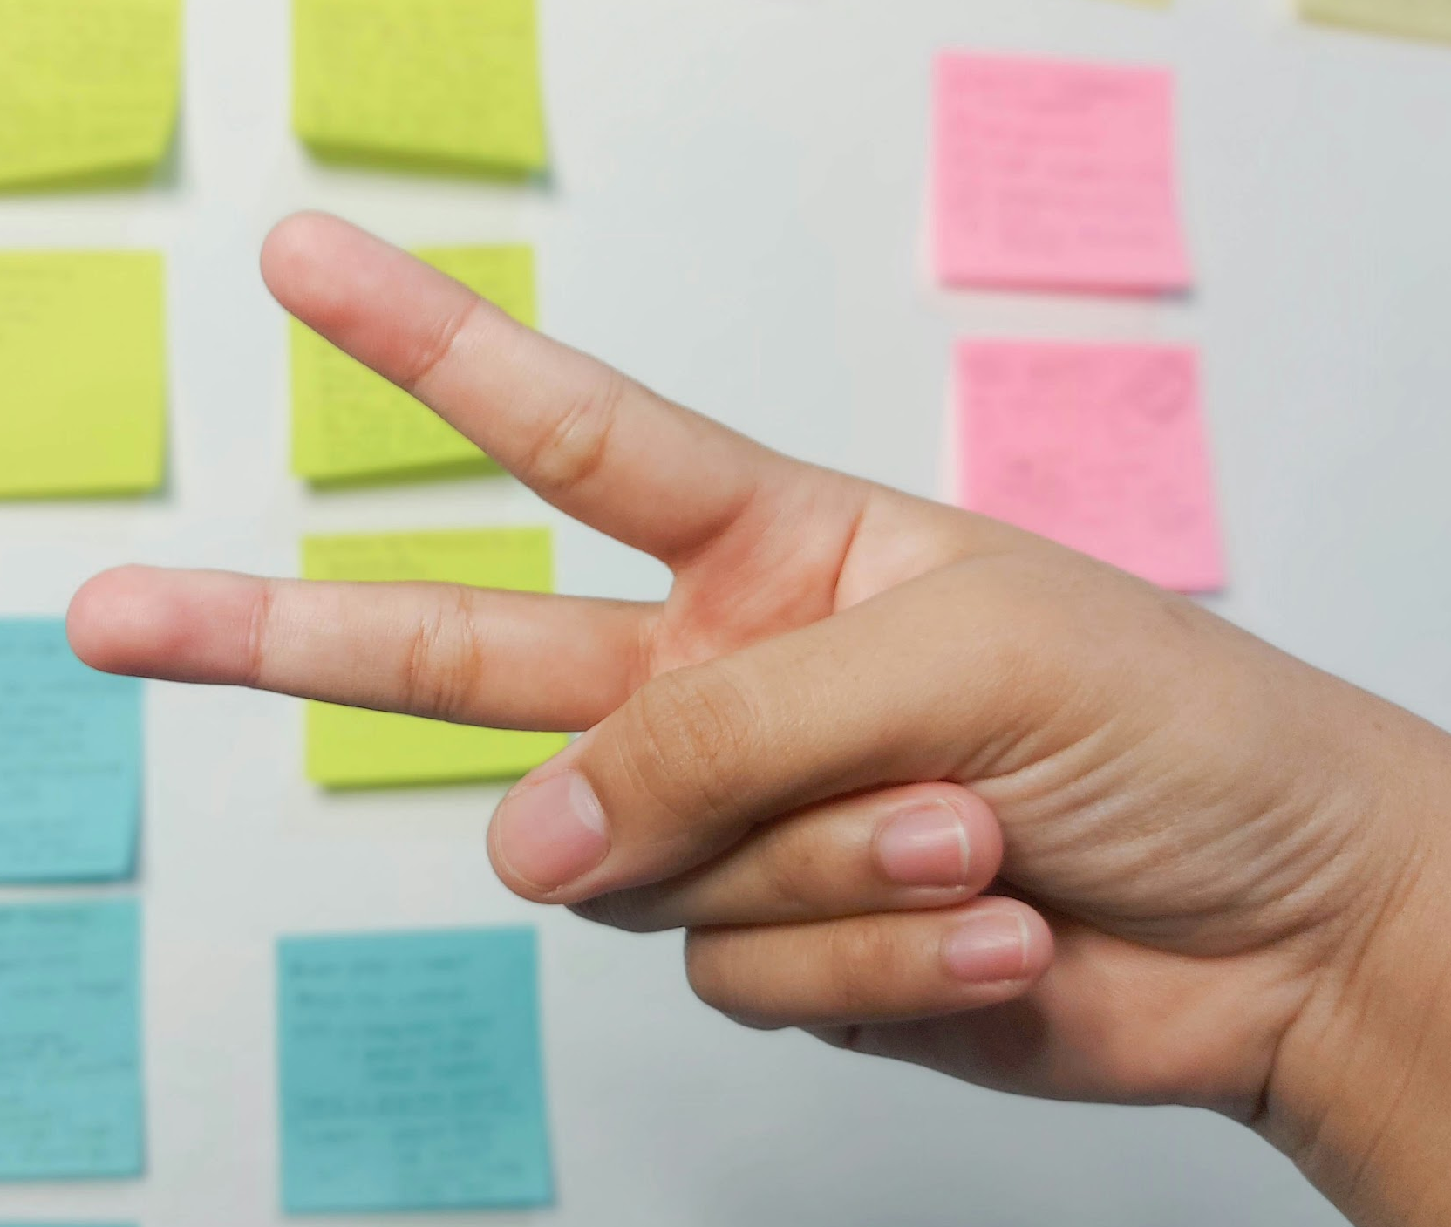


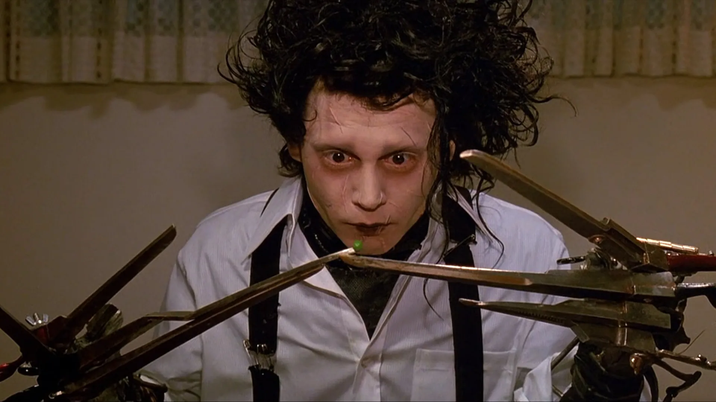
“Mmrps”

Slide 5
Why “MMRPS”?
It’s a universally-understood game with little explanation required
It’s an accessible game (anyone can play with minimal “skill”)
It’s easy to set up (just needs you and your hands!)
We had to “define the rules” (participation, on-draw, win/loss, reward)
It’s quick to play (very short play session)
It’s participatory (even as spectators!)
A good icebreaker for designing games!

Slide 6
What is “Game Design”?
Game design is a process of making rules, systems, and mechanics that define a game.
IDEATE
EVALUATE
CREATE
TEST

Slide 7
What is “Game Design”?
It is not simply “coming up with ideas” – everyone has ideas – instead, design is about bringing those ideas to life with intent and understanding.
Game design requires designers to think about numerous things:

Slide 8





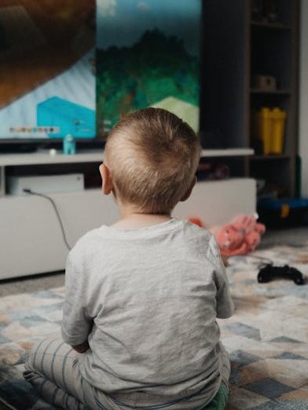
What is “Game Design”?
players: who they are, what they (dis)like to play, and their experiences of games
Console Gamers
Party Gamers
Older/Elderly Gamers
Mobile Gamers
Family/Relationship Gamers
Young
Gamers

Slide 9
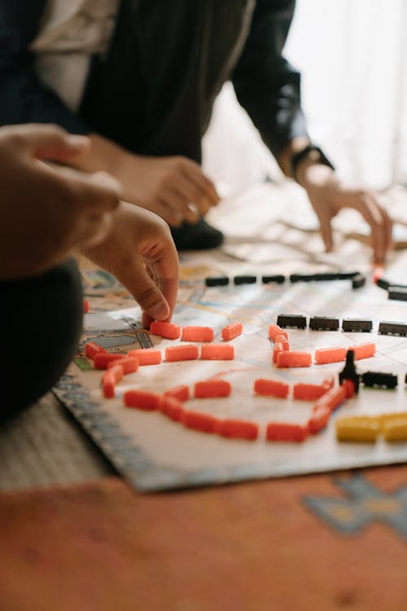


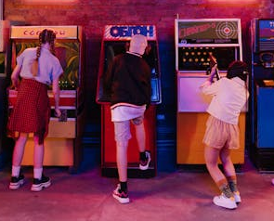
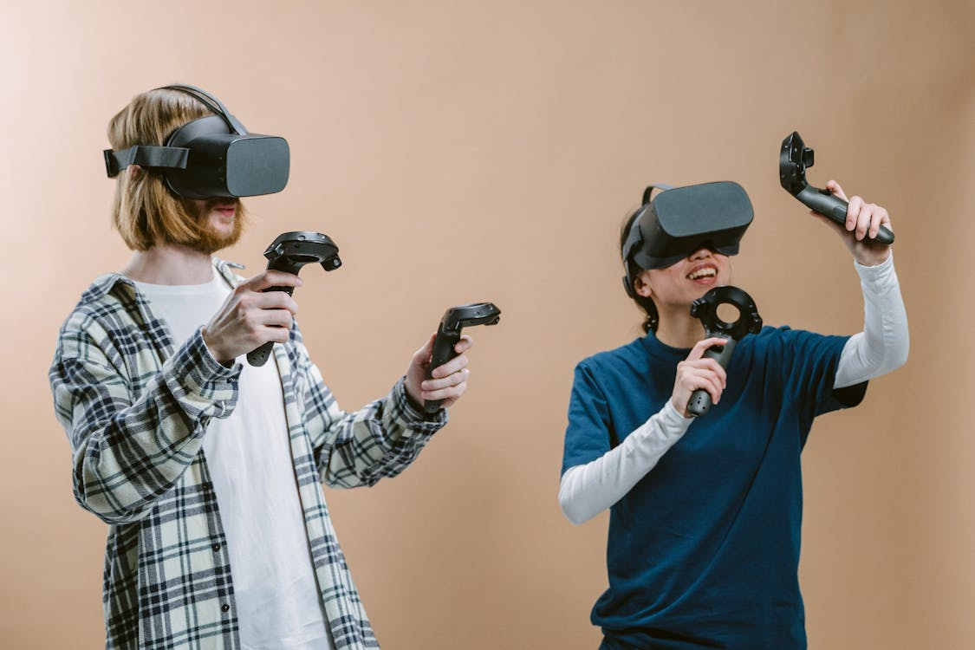
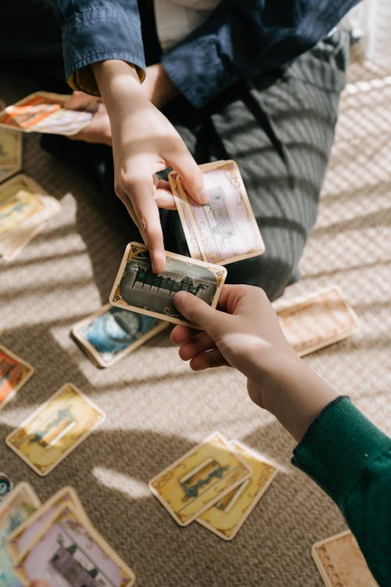
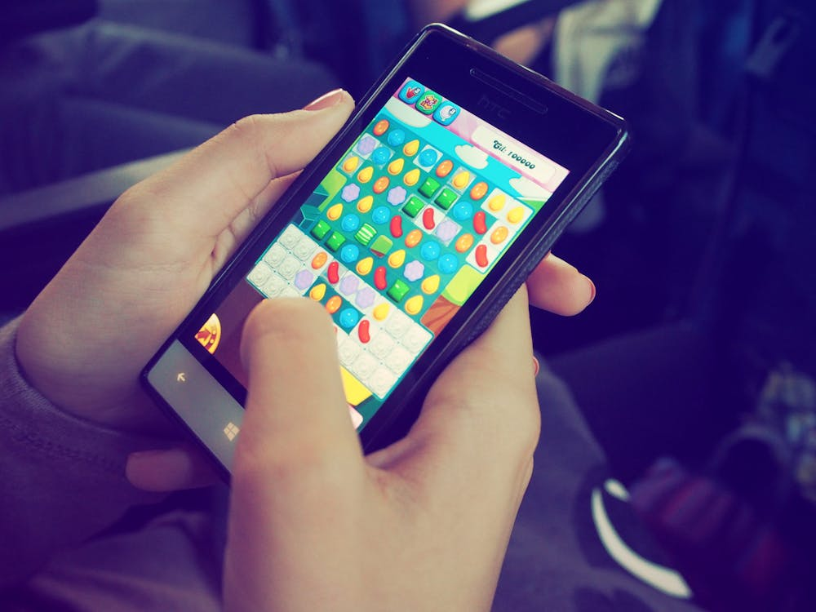
What is “Game Design”?
platforms: understanding their strengths, limitations, and “affordances” (player capabilities and accessibility)
Board
Bespoke
Consoles/PC
Arcades
Virtual Reality (VR)
Cards
Mobile/Handheld

Slide 10




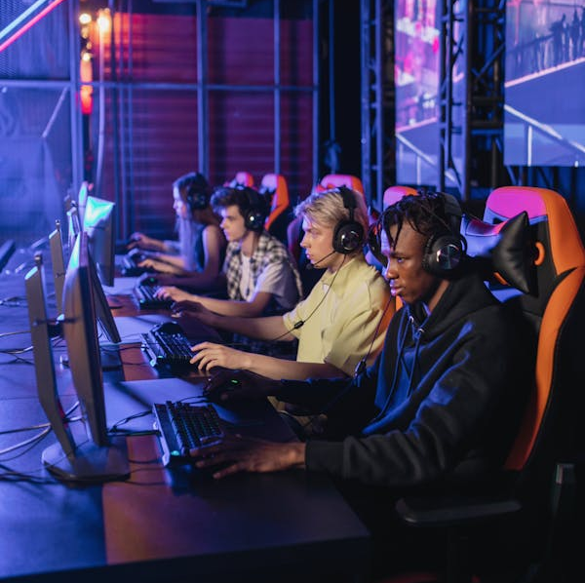
What is “Game Design”?
play: the rules and mechanics that dictate how a player plays the game
Competition
Chance/luck-based
Physical (Performative)
Social
Collaboration

Slide 11
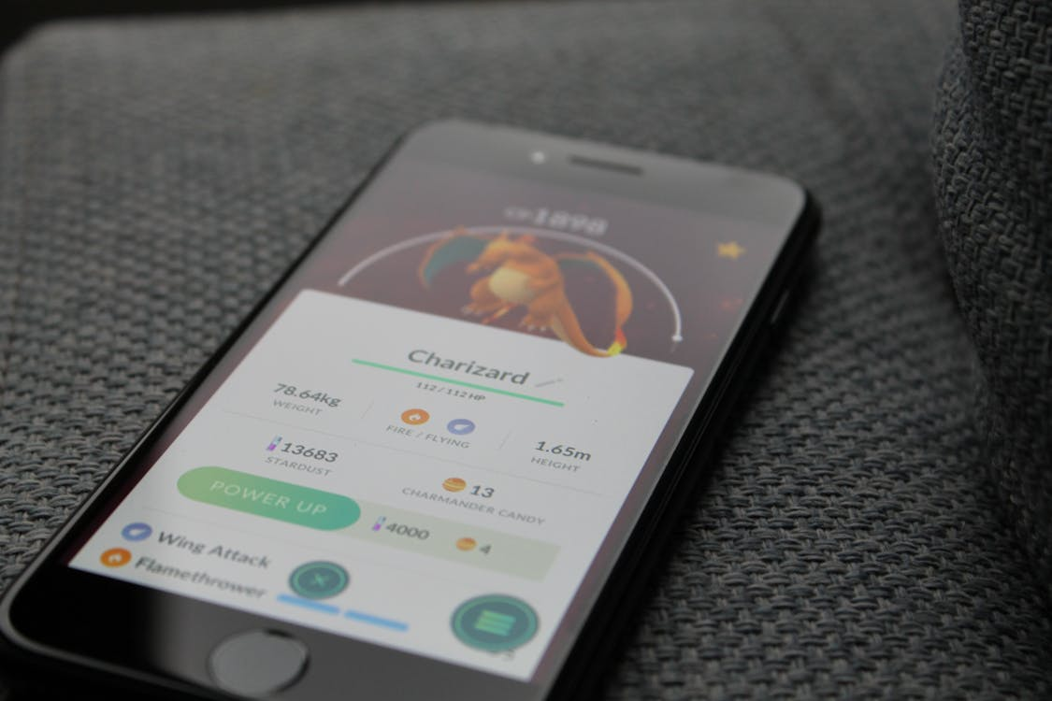
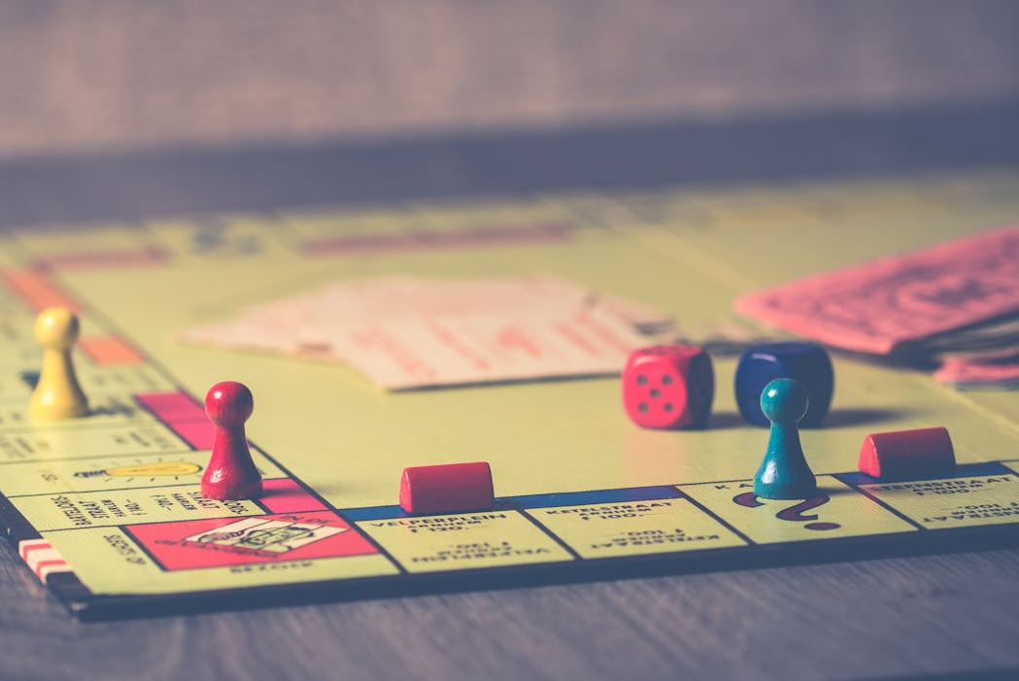

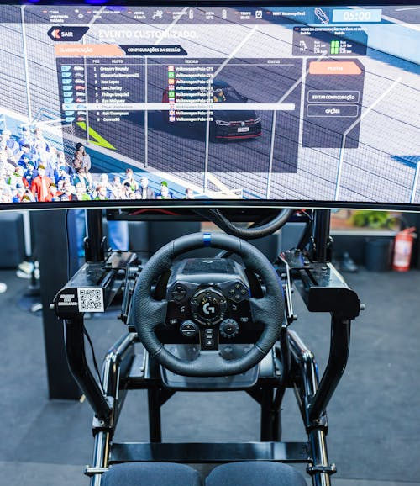
What is “Game Design”?
purpose: why people might play games, whether the game is for entertainment or other uses
Fitness
Educational
Simulation/Experiential
Training

Slide 12
Task One: Ideation
Researching, experimenting, and identifying as many ideas as possible
IDEATE
EVALUATE
CREATE
TEST

Slide 13
Task One: Ideation
For this exercise, we are going to use an ideation technique called Morphological Analysis – initially used in engineering, this has become a useful technique to explore as many possible solutions to a complex problem as possible in a short time period.
It requires us to:
Establish Components of what we are designing;
List possible Characteristics related to each Component;
Establish our Criteria for design by selecting one Characteristic per column.
We write our ideas on a post-it note and add it to the pile – there is no such thing as a “bad” or “wrong” idea!

Slide 14
Task One: Ideation
Example of Morphological Analysis:
Component
Player | Platform | Play | Purpose
Adolescents | PC/Console | Discovery | Education
Parties | Mobile | Expression | Entertainment
Professionals | Tabletop (Board/Card) | Competition | Training
Characteristics

Slide 15
Task One: Ideation
Example of Morphological Analysis:
Player | Platform | Play | Purpose
Adolescents | PC/Console | Discovery | Education
Parties | Mobile | Expression | Entertainment
Professionals | Tabletop (Board/Card) | Competition | Training
Criteria
Adolescents
Mobile
Competition
Training

Slide 16
Task One: Ideation
Example of Morphological Analysis:
Player | Platform | Play | Purpose
Adolescents | PC/Console | Discovery | Education
Parties | Mobile | Expression | Entertainment
Professionals | Tabletop (Board/Card) | Competition | Training
Adolescents
Mobile
Competition
Training
A detection game where you find fact from “fake news” and post scores to an online leaderboard.
Compete against your self-set fitness goals with in-built advice on diet, nutrition, and exercise techniques.
A daily, single logic question on a unique topic with “streaks” for getting the most consecutive answers correct.
(5 mins)

Slide 17
Task One: Ideation
Example of Morphological Analysis:
Player | Platform | Play | Purpose
Adolescents | PC/Console | Discovery | Education
Parties | Mobile | Expression | Entertainment
Professionals | Tabletop (Board/Card) | Competition | Training
Parties
Tabletop
Discovery
Education
Teams draw cards of historical events and have to place these within the correct decade.
Players work together to piece together evidence from a crime scene and solve the mystery.
A detection game where you find fact from “fake news” and post scores to an online leaderboard.
Players compete in a last-player-standing game of placing capital cities in the correct place on a map.
(5 mins)
Compete against your self-set fitness goals with in-built advice on diet, nutrition, and exercise techniques.
A daily, single logic question on a unique topic with “streaks” for getting the most consecutive answers correct.

Slide 18
Task One: Ideation
Example of Morphological Analysis:
A detection game where you find fact from “fake news” and post scores to an online leaderboard.
Teams draw cards of historical events and have to place these within the correct decade.
Players compete in a last-player-standing game of placing capital cities in the correct place on a map.
Compete against your self-set fitness goals with in-built advice on diet, nutrition, and exercise techniques.
A daily, single logic question on a unique topic with “streaks” for getting the most consecutive answers correct.
Players work together to piece together evidence from a crime scene and solve the mystery.
(repeat again and again and again to build a “bank” of ideas to work with!)

Slide 19
 | Players | Platforms | Play | Purpose
1
2
3
4
5
6

Slide 20
 | Players | Platforms | Play | Purpose
1 | Teenagers (13-17) | Escape Room | Competition | Training / Skill Development
2 | First-time Gamer | Tabletop (Board/Card) | Simulation | Health / Wellness
3 | Couples | Mobile/Handheld | Collaboration | Public Information / Awareness
4 | “Boomer” Generation (60+) | Virtual Reality (VR) | Expression / Creativity | Education / Learning
5 | Impaired (Cognitive, Physical, etc.) | PC/Console | Challenge | Entertainment
6 | Children (3-12) / Families | Arcade | Luck-based | Brand Advertisement

Slide 21
Break

Slide 22
Task Two: Creation
IDEATE
Developing a concept or prototype of an idea that can be played
EVALUATE
CREATE
TEST

Slide 23
Task Two: Creation
Now that we have a list of ideas, we are going to select one and make a paper prototype.
A paper prototype is a rough version of your game which can be played using paper (no code, visuals, sounds, or computers simulating the rules!)
Paper prototypes are quick and inexpensive ways to test if the core idea of your game works as intended before spending time with its development – it’s much easier to change something in your game at this stage than after years of development!
Anything in a game can be turned into a paper prototype…

Slide 24
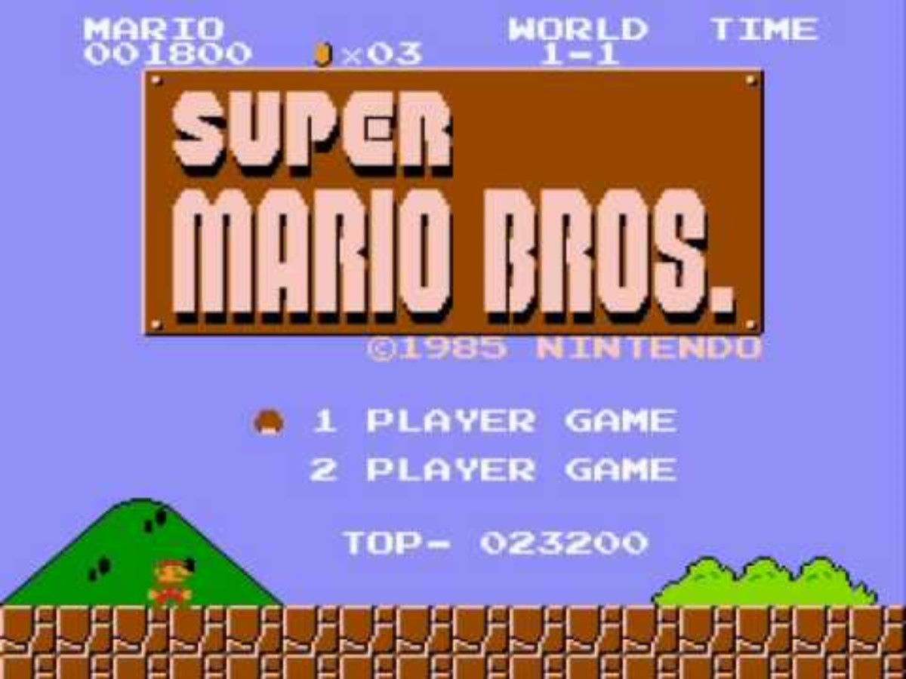
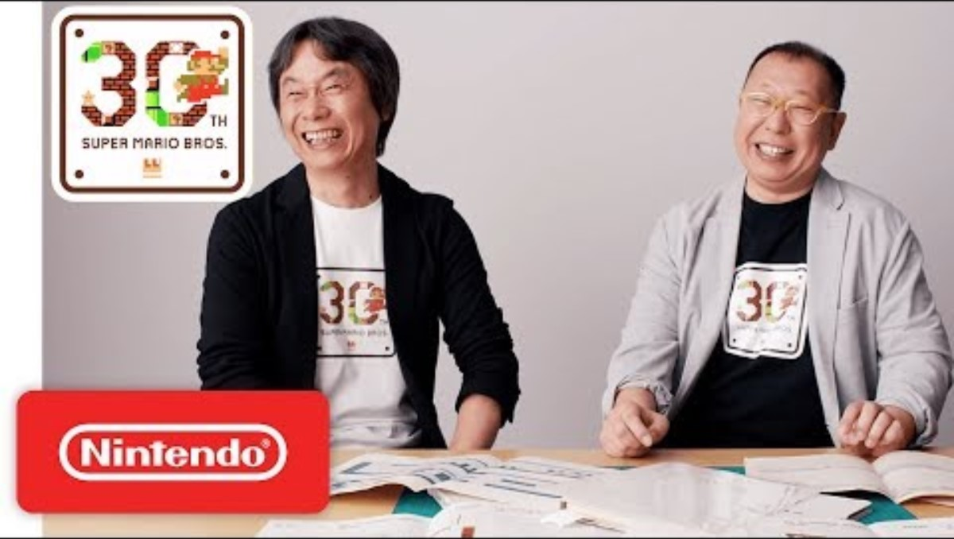
Task Two: Creation
“Platformer” Game
Game (Super Mario Bros.)
Paper Prototype (Super Mario Bros.)

Slide 25
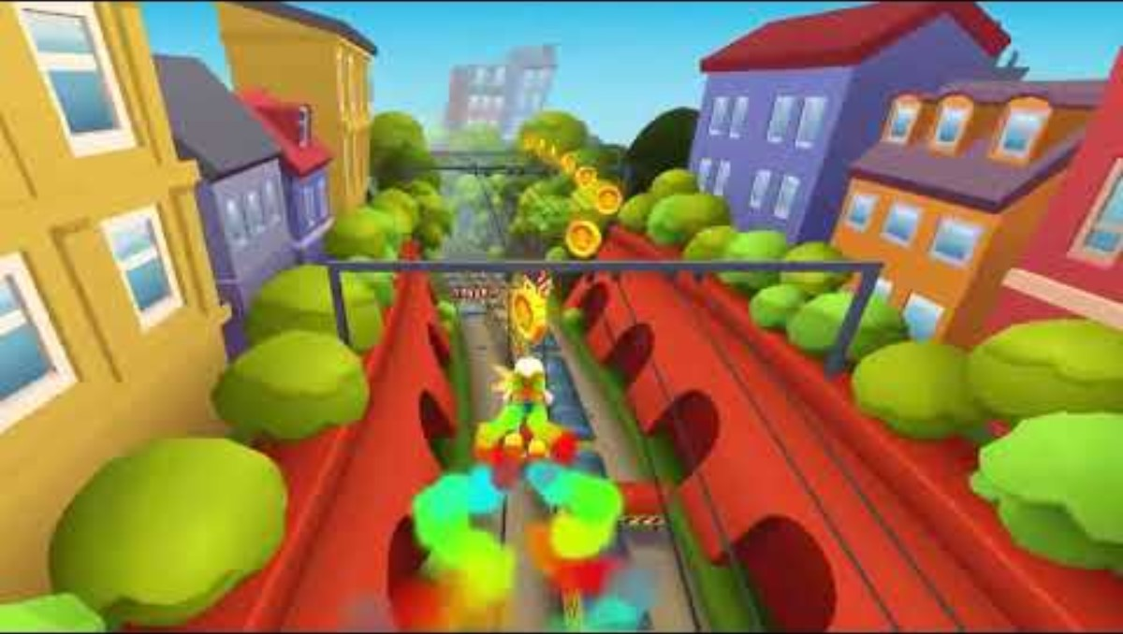
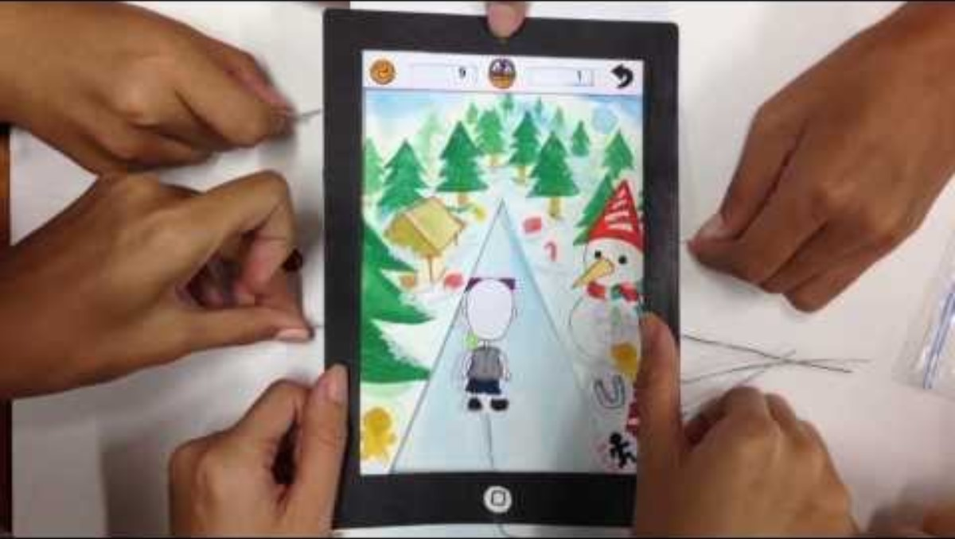
Task Two: Creation
“Endless Runner” Game
Game (Subway Surfers)
Paper Prototype (Runsii)

Slide 26
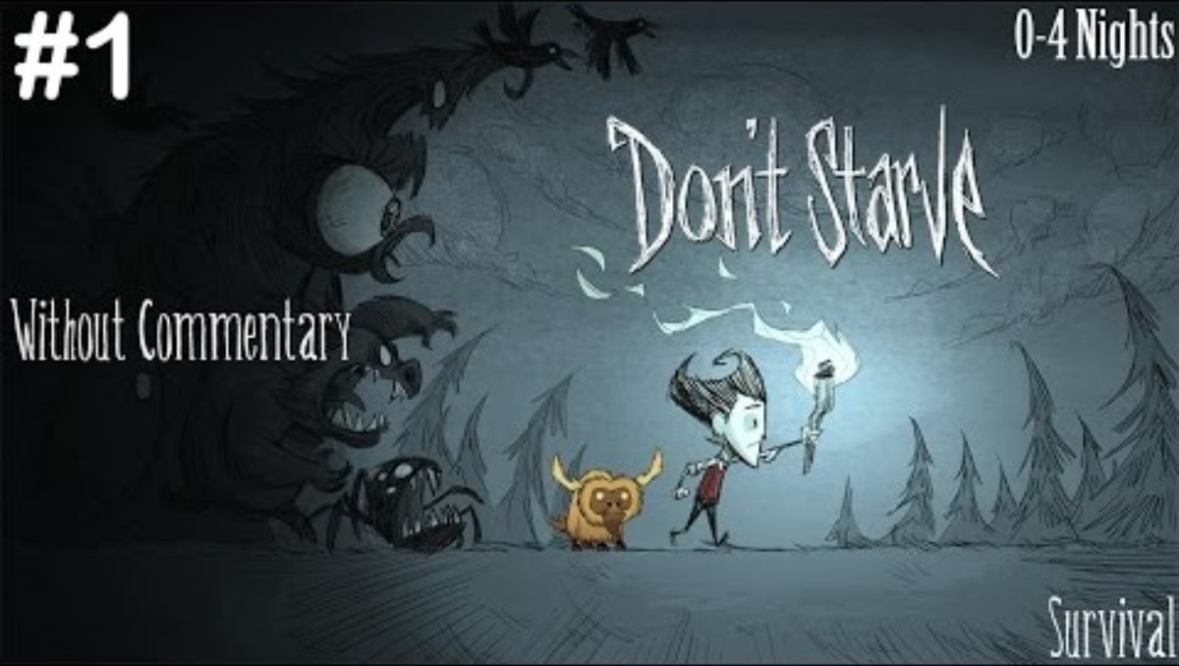
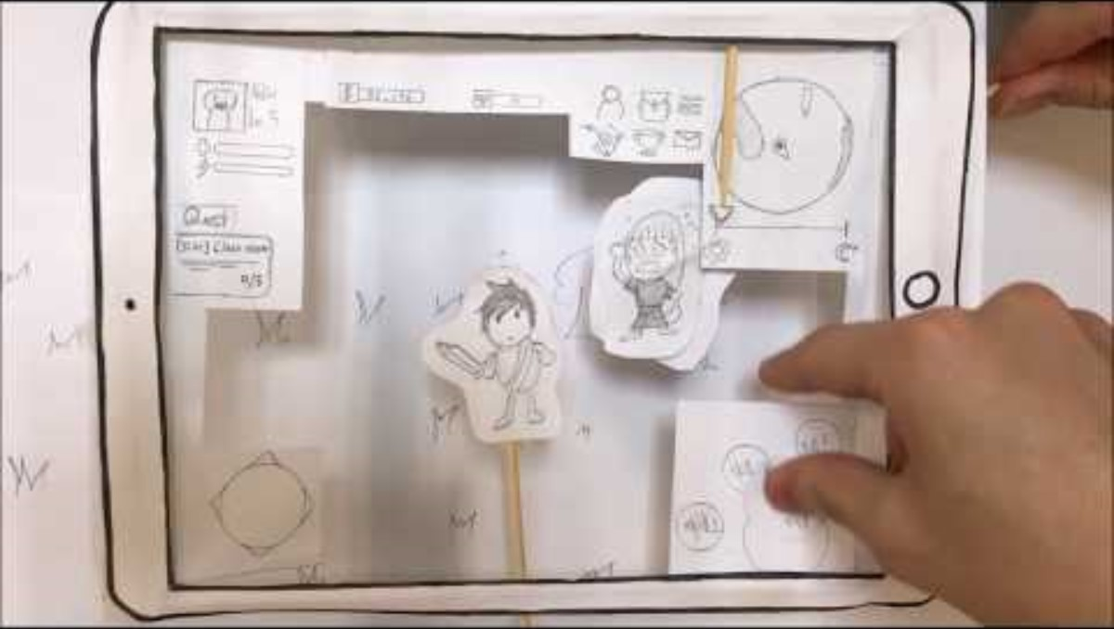
Task Two: Creation
“Adventure” Game
Game (Don’t Starve)
Paper Prototype (The Secret of the Funfair)

Slide 27
Task Two: Creation
Now it is your turn!
Think about a simple scenario in your game (perhaps the first level or scene!) and what this will contain:
Rules: How to play, How to set-up, What is/isn’t allowed, …
Characters: Player, Enemies, Allies, …
Backgrounds: In-game, Menus, Cut-scenes, …
Mechanics: Running, Jumping, Selecting, …
Story: Narrative, Speech Bubbles, Text Boxes, …
Think about how you might represent your game through paper prototypes as best you can – use the internet for examples or ask for guidance!

Slide 28
Lunch

Slide 29
Task Three: Testing
IDEATE
EVALUATE
CREATE
Testing the idea with others and making notes on what does(n’t) work
TEST

Slide 30
Task Three: Testing
To make our game the best that it can be, we need to test this game with players and capture what they think.
We might want to know what a player:
Likes or dislikes about the game (player preferences)
Can or cannot do within the game (skill/ability versus challenge)
Notices or misses within the game (communication design)
Recommends or suggests to improve the game (ideation)

Slide 31
Task Three: Testing
You will move round a play each others’ games, leaving feedback using your Feedback Sheets (at each game).
Fill this out as much as possible – the more detail you provide in your feedback, the more helpful you will be to the developers!
Please be considerate of each others’ games:
Be encouraging (“this is rubbish” is not good feedback!)
Be gentle (try not to break any game pieces!)

Slide 32
Takeaways: Next Step
IDEATE
come up with new ideas?
Planning what to do next with the game
EVALUATE
create a new solution?
CREATE
TEST

Slide 33
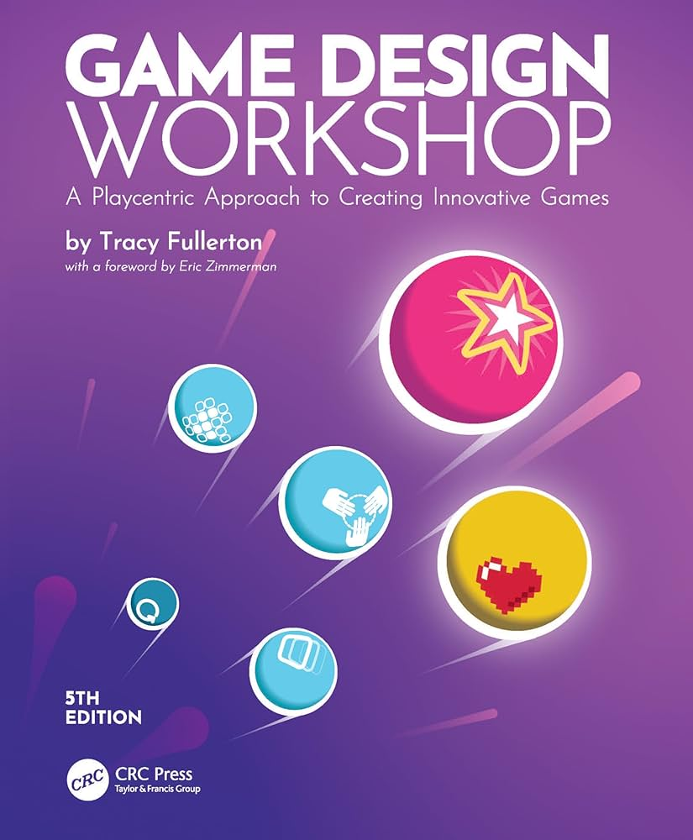

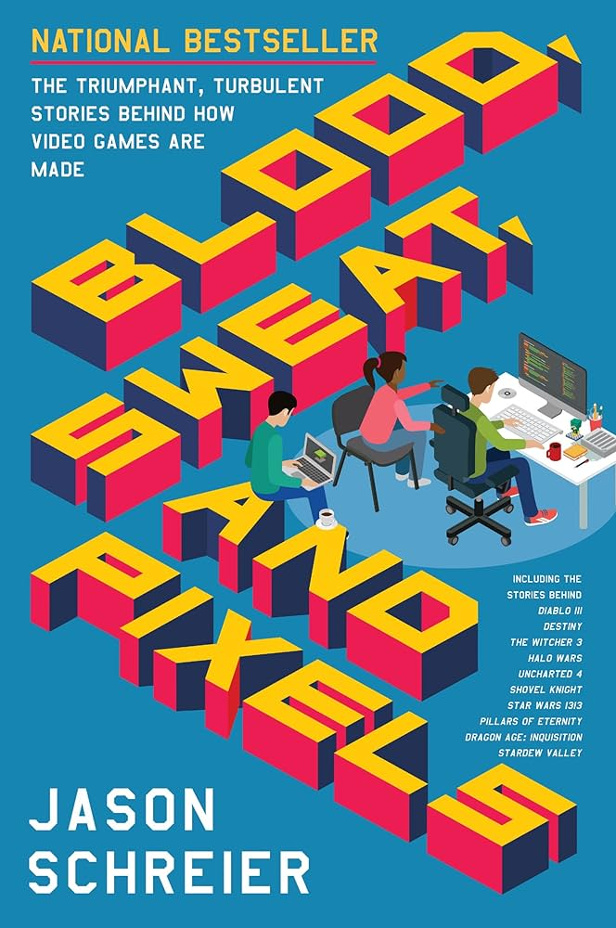
Takeaways: Resources
Game Design Workshop: A Playcentric Approach to Creating Innovative Games (5th Edition)
Game Maker’s Toolkit
(YouTube Channel)
Blood, Sweat and Pixels: The Triumphant, Turbulent Stories Behind How Video Games are Made

Slide 34
Thank You!

