Slide 1




Game Engines Workshop
Include+ Project
July 2024

Slide 2
Today
GameMaker
Task One: Building an Arcade Shooter Game
Task Two: Tweaking and Adapting Our Game
Task Three: Playtesting Games (Dare Academy)
(this will be followed by lunch and Workshop 3: Game Audio)

Slide 3

GameMaker is a 2D-based game engine that can be used to create games for a variety of platforms (PlayStation, Xbox, Switch, PC, mobiles and tablets, and TVs!)
It is a very accessible tool that is friendly to beginners looking to venture into game development – and the company is based here in Dundee!
Benefits include:
Free to download (for creating non-commercial projects)
Encompasses all disciplines (used by designers, artists, coders, and audio engineers)
Rich volume of tutorials and sample projects (useful for starting out)
Active community support (web pages and forums providing sample code and solutions)

Slide 4
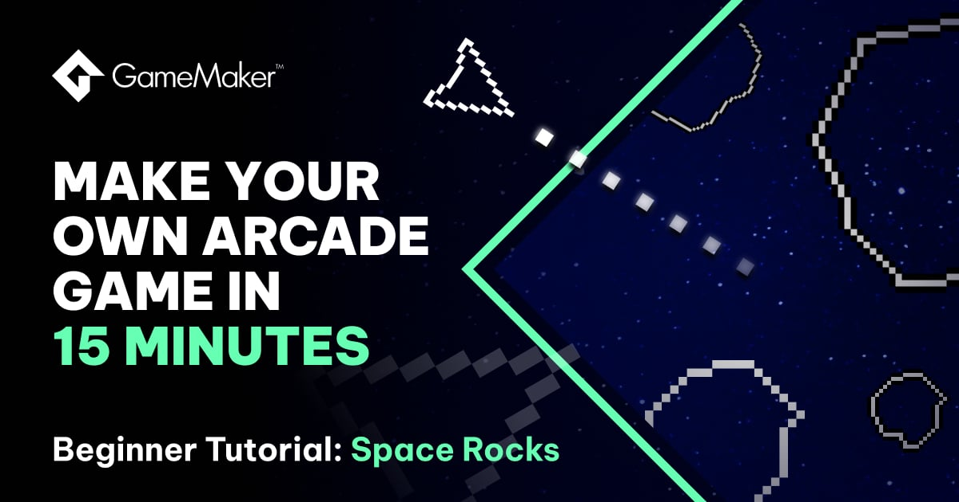
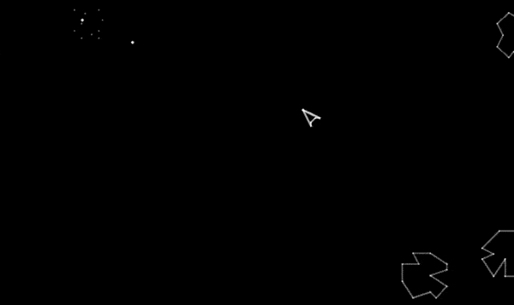
Task One: Building an
Arcade Shooter game

Slide 5
Task Two: Tweaking and
Adapting Our Game
We have a game that works and can be played. But is it exciting or different?
We might want to start changing parts of the game to make our version unique (and therefore stand out from a crowd of games!)
We are going to spend the remainder of this session changing aspects of our game and enhancing the experience…

Slide 6
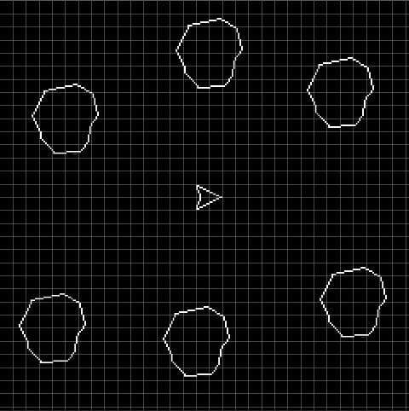



Task Two: Tweaking and
Adapting Our Game
What elements can be changed?
Player Ship: presentation, speed, special effects
Rocks: presentation, variation, durability, fragmentation, special effects
Bullets: presentation, fire rate, special abilities, special effects
Game Logic: scoring, lives, prompts and warnings
Background: presentation, theme

Slide 7
Task Two: Tweaking and
Adapting Our Game
Design challenges to elevate your game further…
Screens: can you create Start Game and End Game screens?
Multiplayer: can you involve 2+ players in the game at one time?
Stages: can you create levels of scaling difficulty?
Enemies: can you introduce different types of obstacles/targets?
Leaderboard: can you save and show the top score(s)?
Theme: what if the game wasn’t set in space – where would it take place?

Slide 8
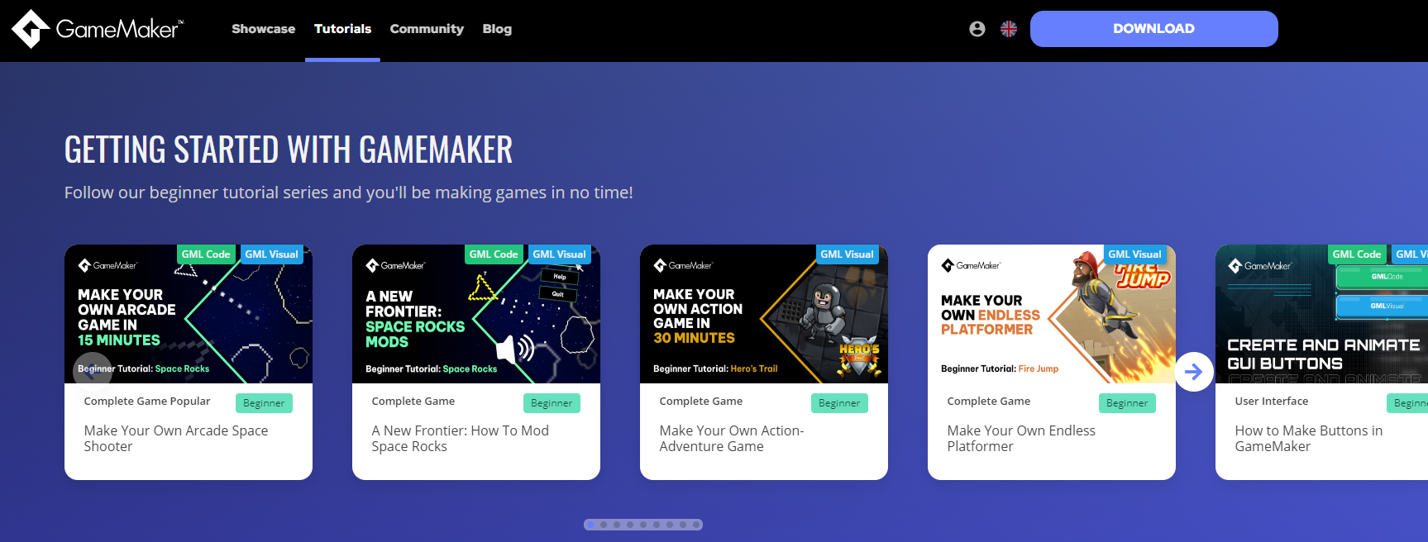
Task Two: Tweaking and
Adapting Our Game
(lots of tutorials, examples, and guides on the GameMaker website – it’s free!)

Slide 9



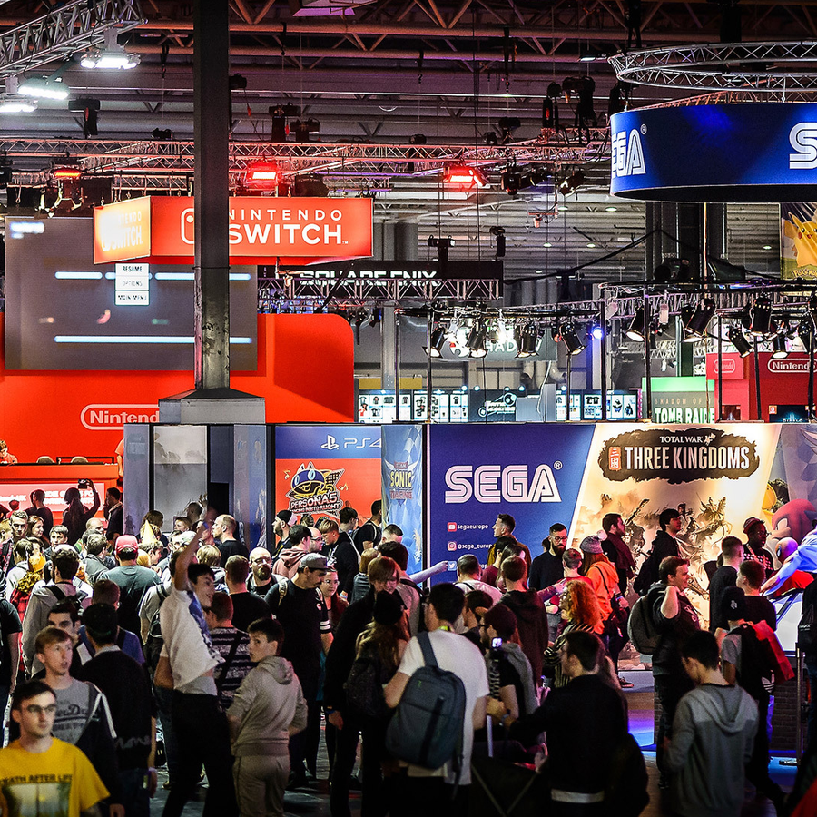

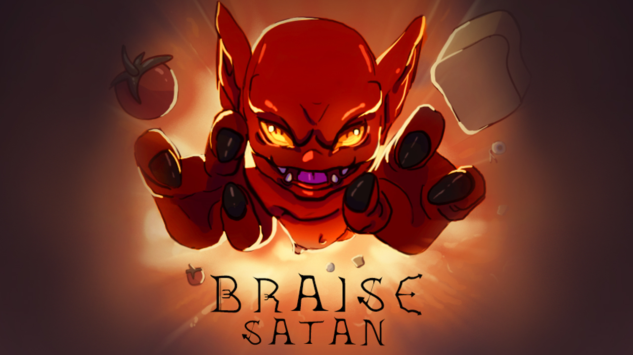
Task Three: Playtesting Games

Slide 10
Thank You!

