Slide 1
Audio Workshop
July 17th

Slide 2
Agenda
Time | Task
13:00 | Meet at V&A Dundee
13:05 | Listening Practice / Soundwalk
13:40 | Introduction to Sound Design
14:00 | Making 1 minute audio drama | Foley Group 1
14:30 |  | Foley Group 2
15:00 | Final editing for the audio drama
15:45 | Presentation
16:00 | End of the workshop

Slide 3

Soundwalk

Slide 4
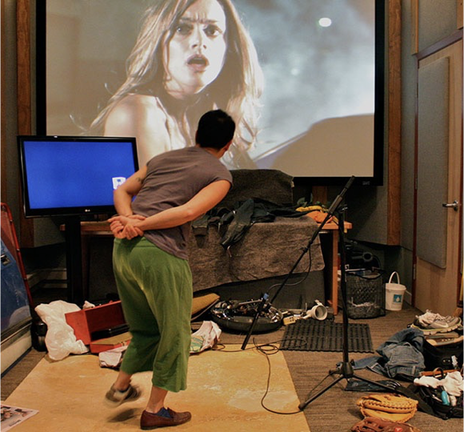
Foley
Sound effect technique that involves recording sounds using props in a studio setting.
Named after the sound effect pioneer, Jack Foley, who worked at Universal Pictures during the 1930s.

Slide 5

Foley Artist

Slide 6
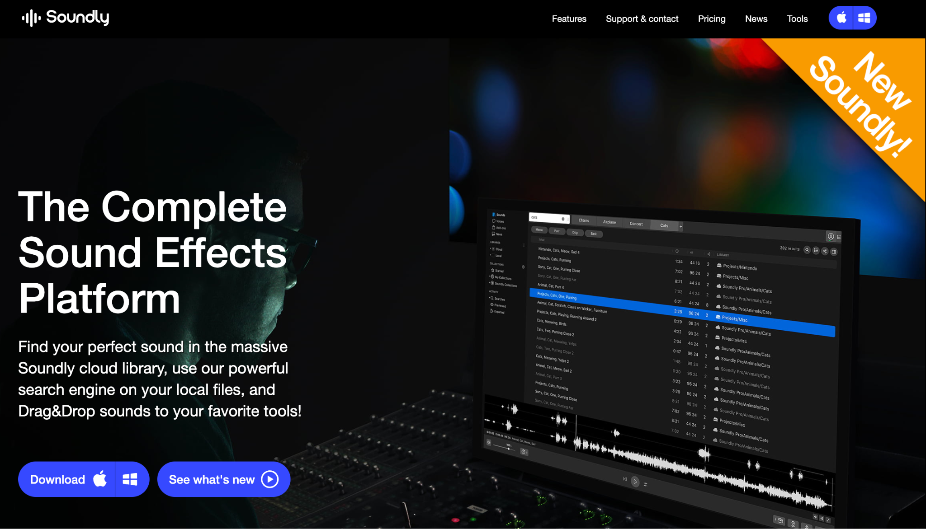
Sound Library - Soundly Demo

Slide 7
Other free online sound libraries
Freesound - https://freesound.org/
BBC Sound Effects - https://sound-effects.bbcrewind.co.uk/

Slide 8
DAW - Reaper (Cheat Sheet)
File > Project Setting | Make sure your sample rate is set correctly. Audio (CD) - 44100 Hz Video - 48000 Hz | Importing Audio | Drag and drop
Play/Stop | Enter key | Send play bar to the beginning | W key
Horizontal Zoom in/out | ↑↓ | Vertical Zoom in/out | Ctrl + Shift + ↑↓
Fader | Hover over the mouse onto the top corner of the sound file / fader icon appears / drag to create fader | Split audio file | S

Slide 9
DAW - Reaper (Cheat Sheet)
Render audio | Select the area you want to render > File > Render > Set Bounds as “Time Selection” > Render 1 file
Applying automation | Click “Trim” button on the track > Select the feature you want to automate
Applying Effects | Click “FX” button on the track > Select Plugins you want to add
Using convolution reverb | Click “FX” button > Select VST: ReaVerb > Click Add button where it says “Impulse response generation” > Select the IRL file you want to use

Slide 10
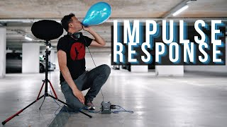
Impulse Response

Slide 11
IR files to download
https://web.archive.org/web/20190201211631/http://www.samplicity.com/bricasti-m7-impulse-responses/ > Try Altiverb files

Slide 12

Game Audio Implementation

Slide 13

Game Audio Middleware

Slide 14
Today’s goal
Make 1 minute audio drama
Rule 1. Don’t use voice over - no narration or dialogue
Rule 2. Use panning for stereo image.
Rule 3. Use reverb for spatialisation.
Rule 4. Export (Render) in .wav / 16 Bits / 48000Hz
Upload your finished audio drama - HERE.

