Slide 1
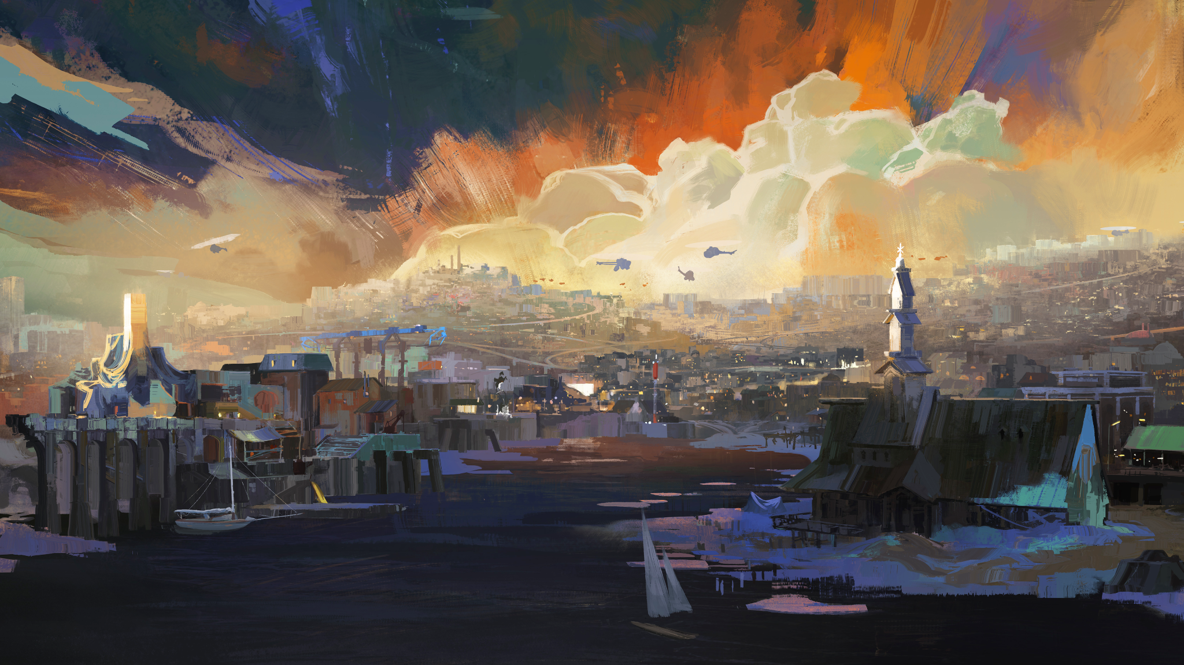
Game Art Introduction

Slide 2
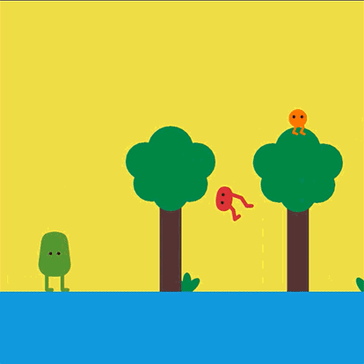
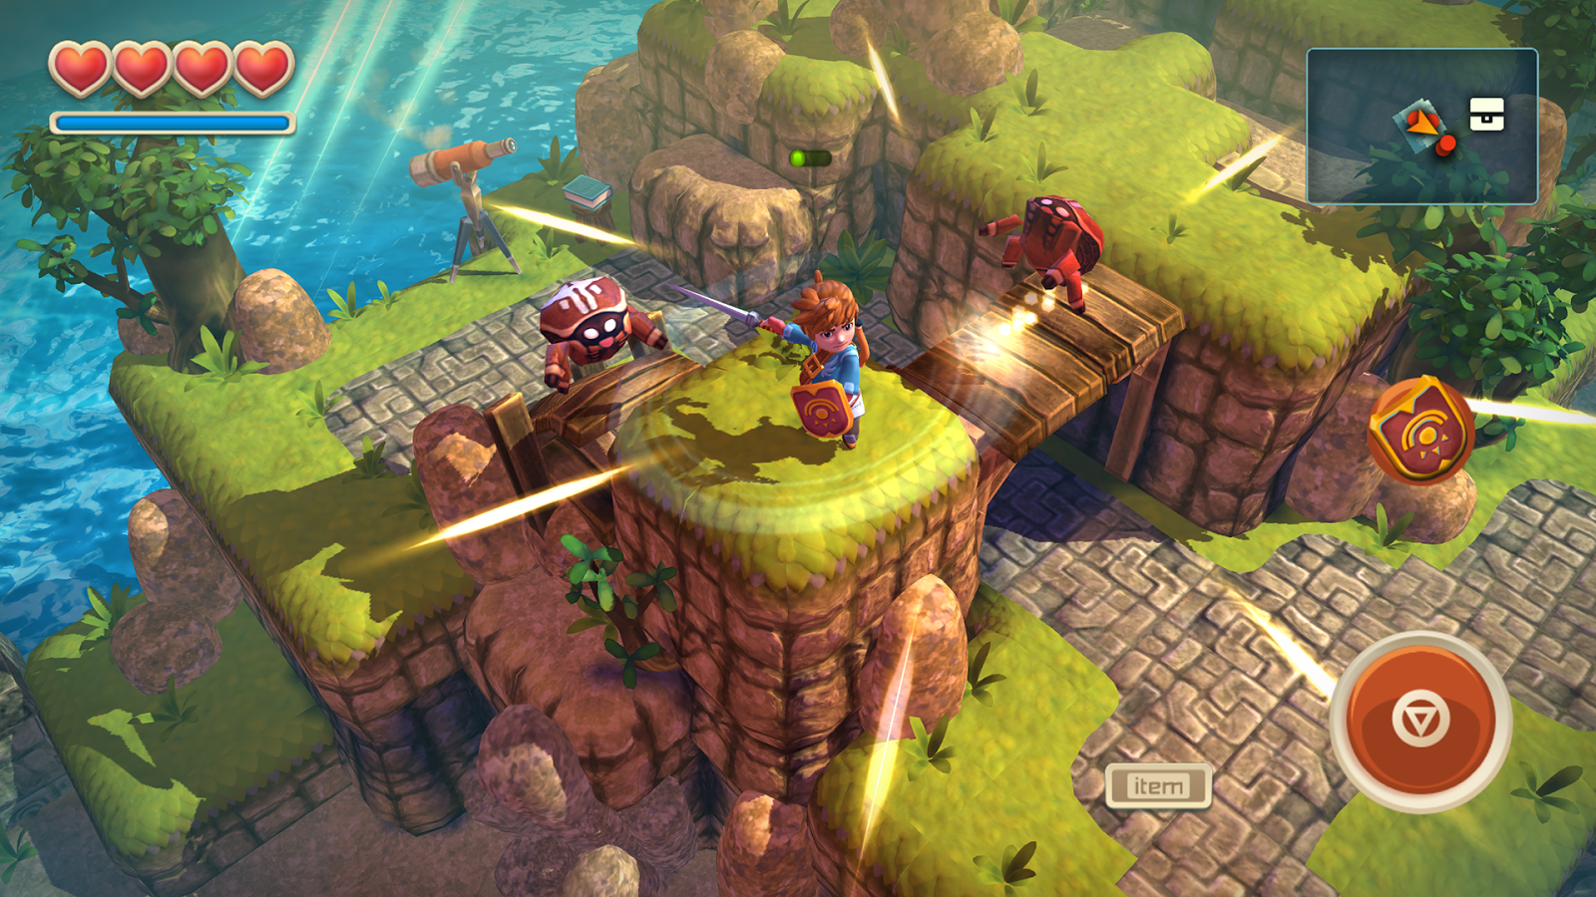
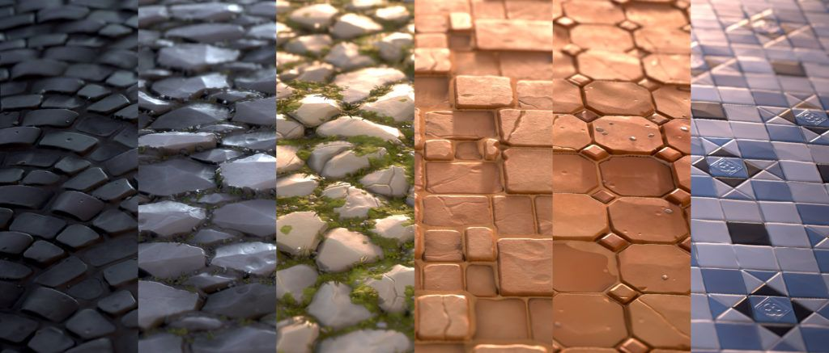
GAME ART

Slide 3
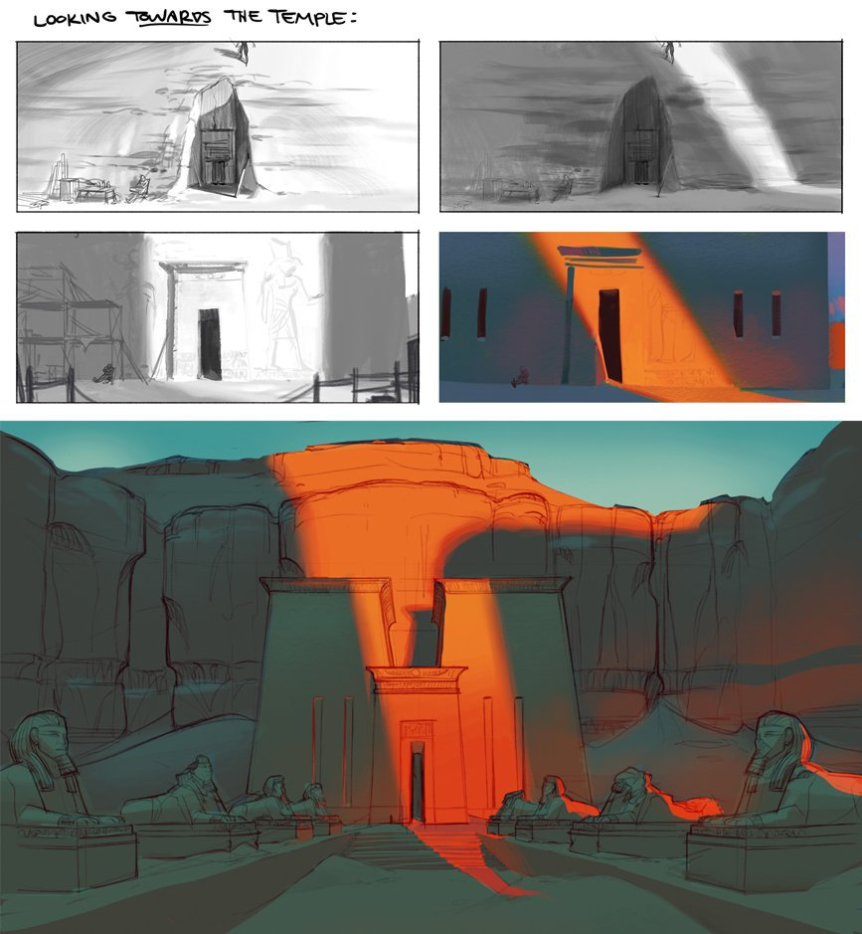
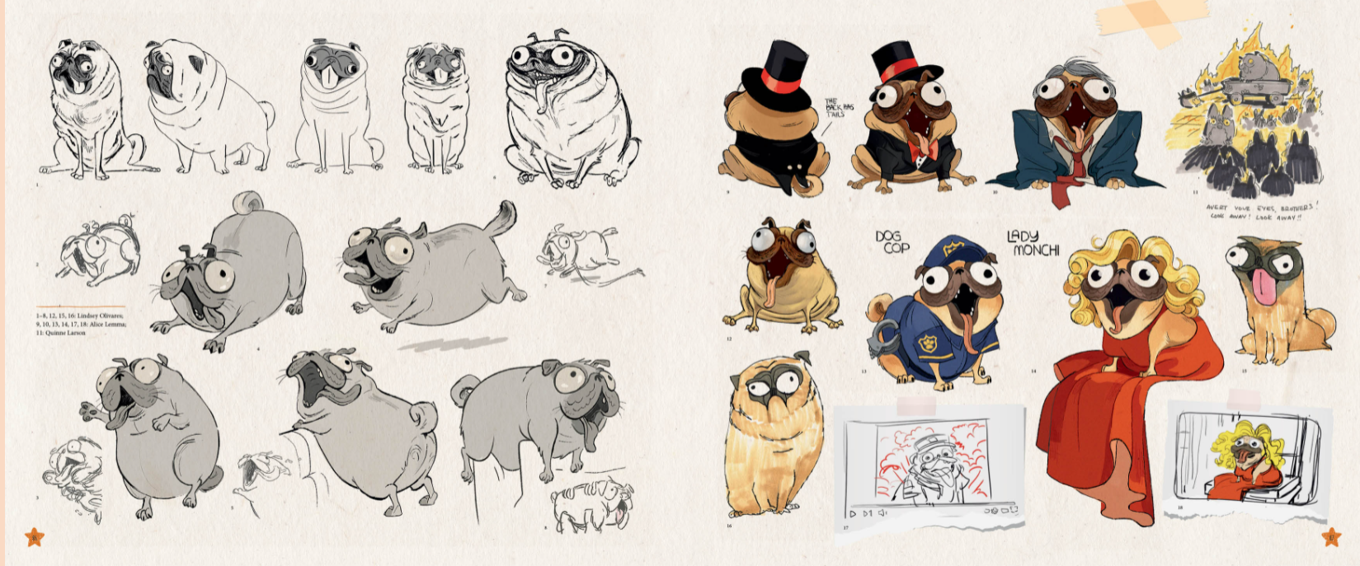
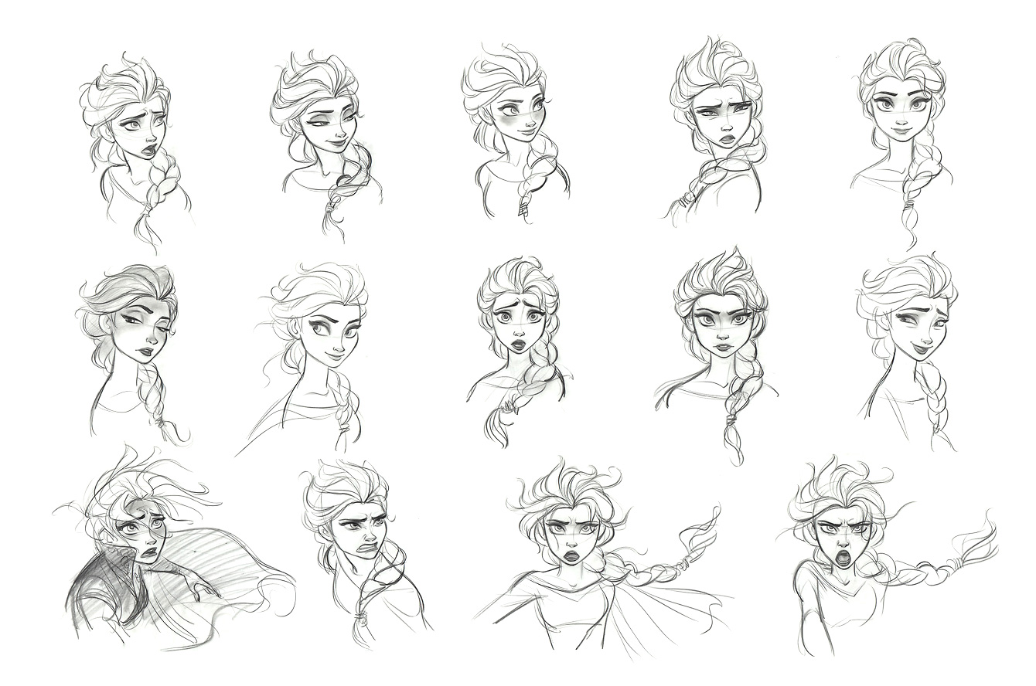
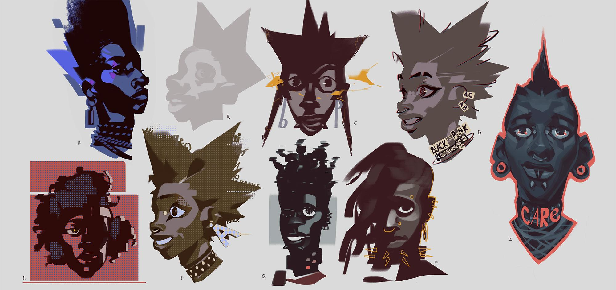
PRE-VISUALISATION (PreVis)

Slide 4
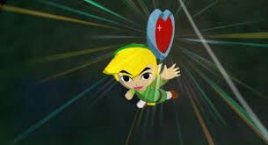
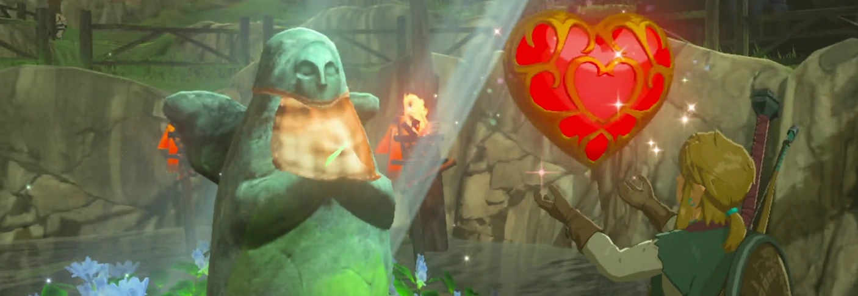
GAME DEVELOPERS ARE
VISUAL COMMUNICATORS

Slide 5
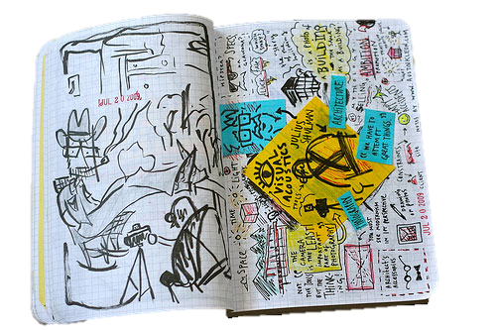
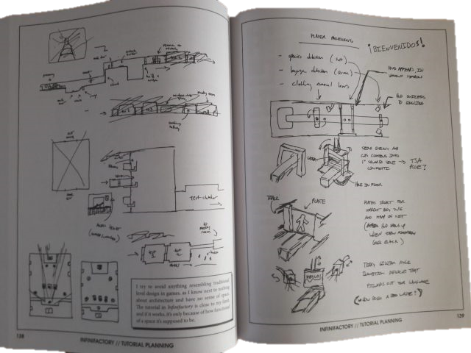
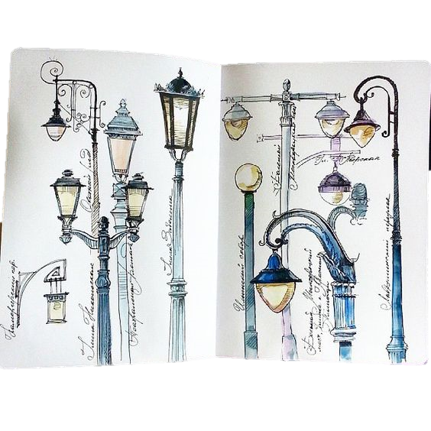
SKETCHBOOKS

Slide 6

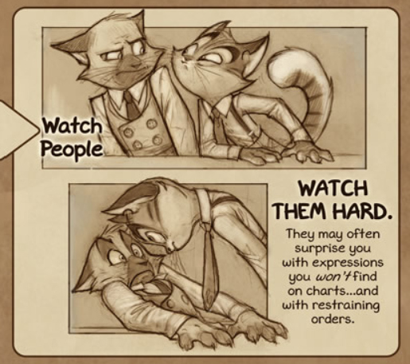
OBSERVATION

Slide 7

BUILD A LIBRARY
In your mind
Building a library of internal references
Developing your communication skills
Help to visualise and develop your games through sketches and diagrams

Slide 8
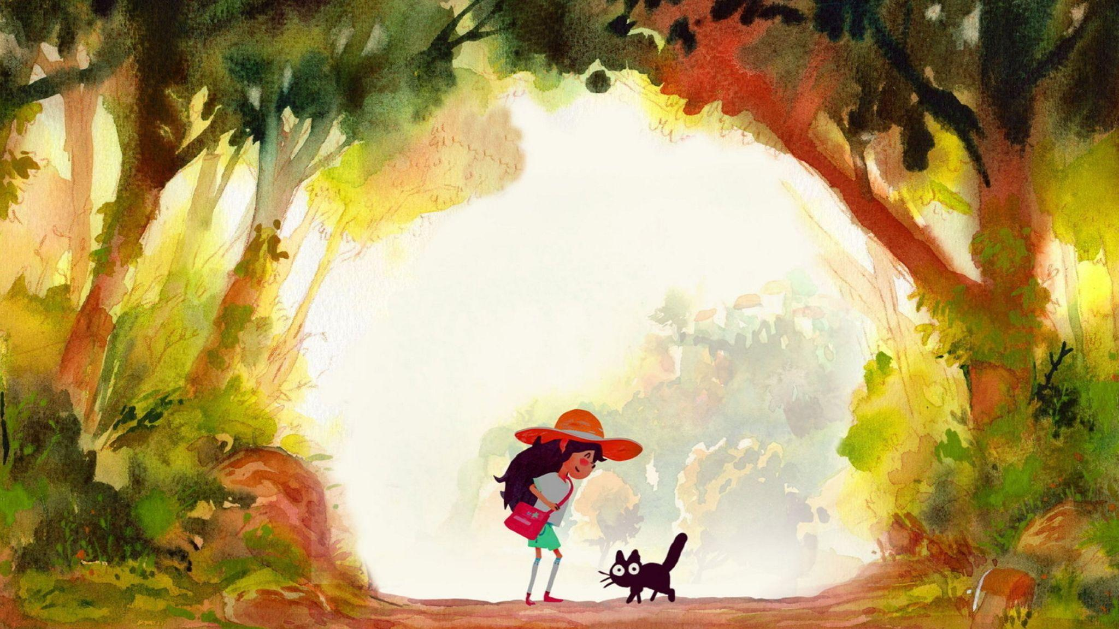

Slide 9
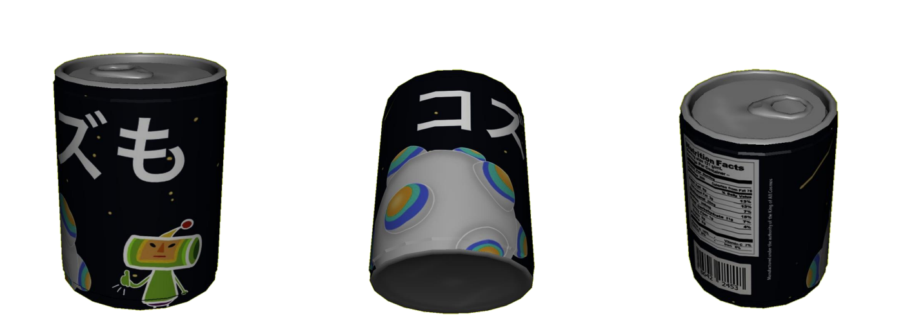
WHAT WE’RE GOING TO DO
✨ DESIGN A DRINK CAN LABEL FOR A 3D GAME OBJECT ✨

Slide 10
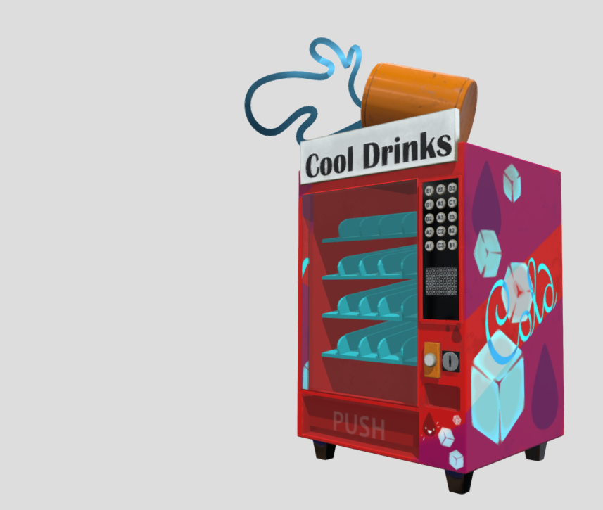
TO GET THERE
Pick a theme
Generate moodboards
Sketch out our design ideas
Moving into 3D - 3D basics
Looking at how to model something - see if you can model your own drinks can - dw if you struggle, i can provide one for you
Very brief intro to what UV mapping is and how it works
Take sketched designs into photoshop to apply texture to can

Slide 11

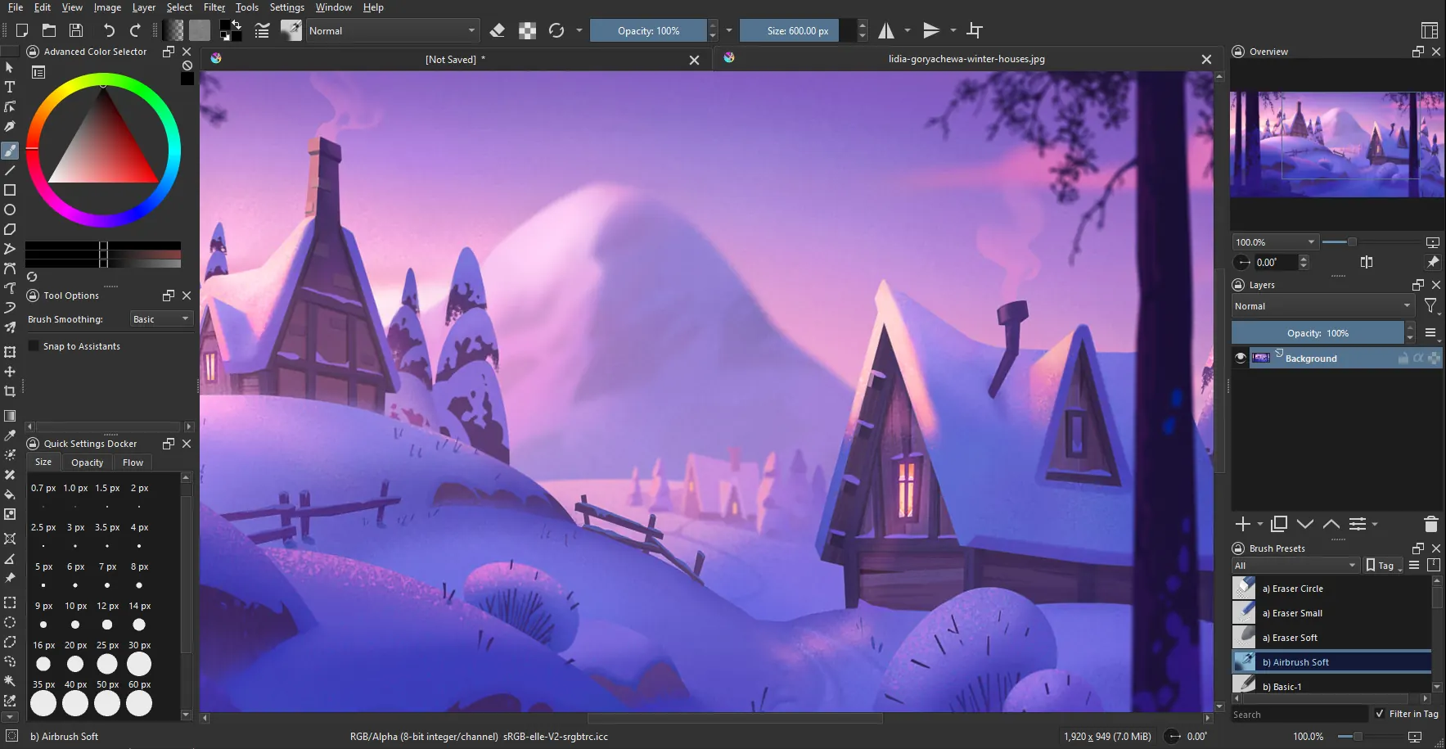
KRITA

Slide 12

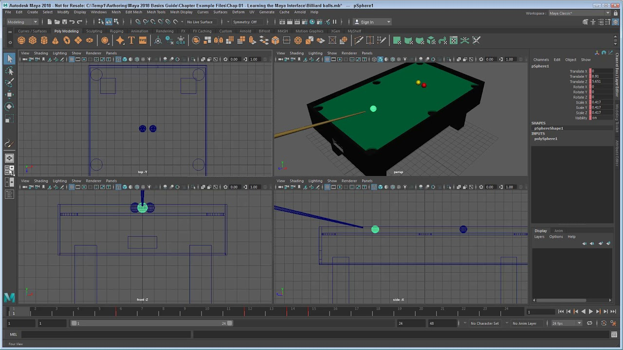
MAYA

Slide 13
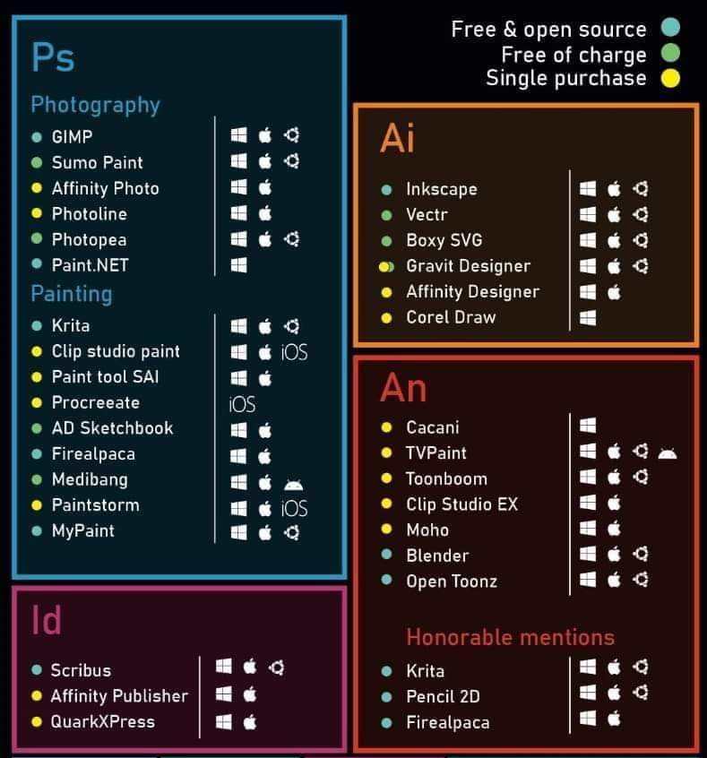

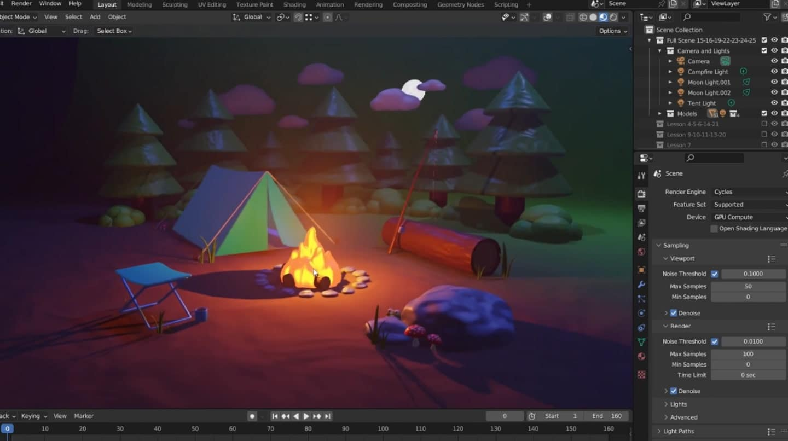


Slide 14
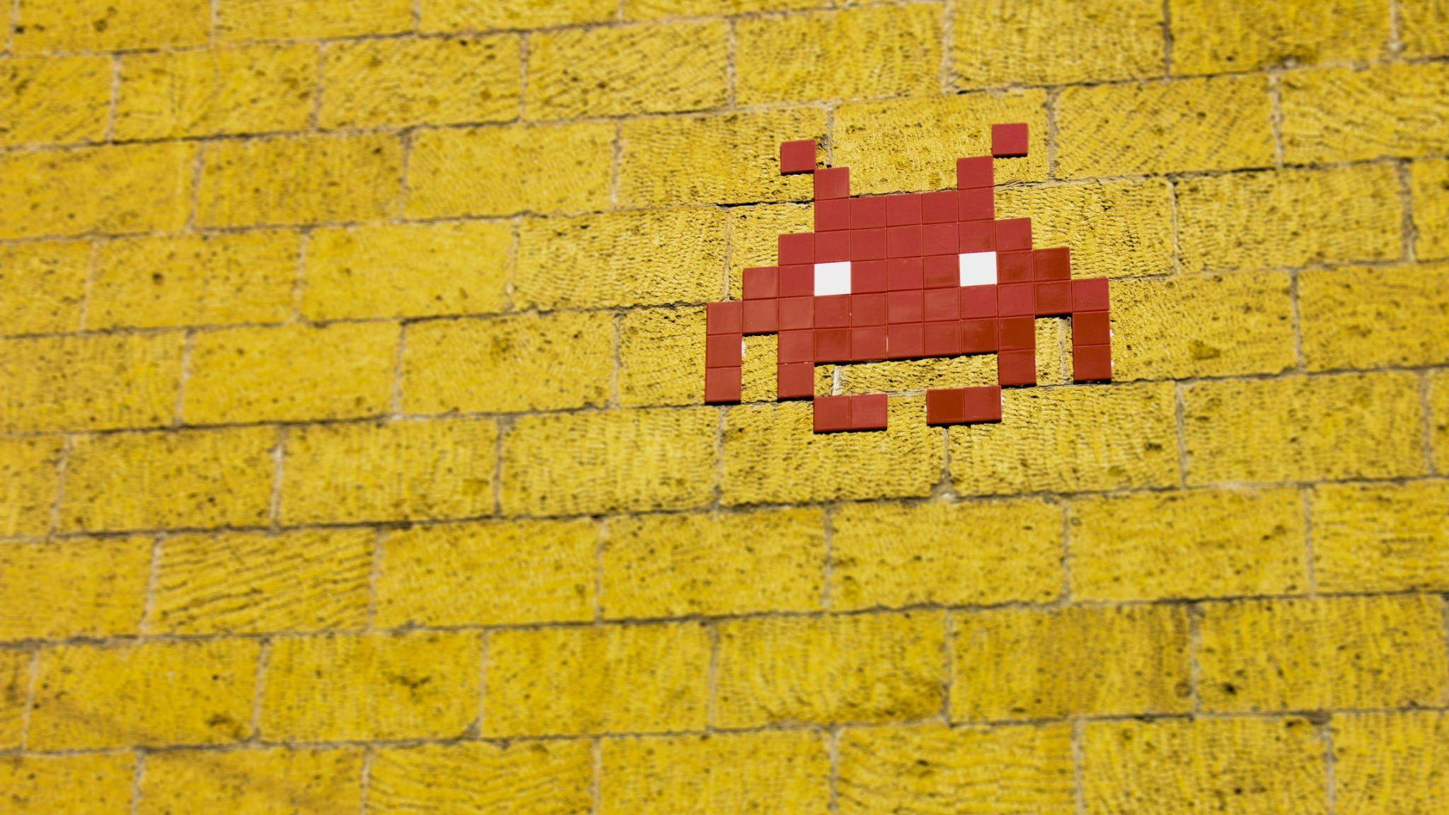
MAKING A MOODBOARD

Slide 15
