Slide 1




Game Jam Workshop
Include+ Project
October 2024

Slide 2
Today
What is a Game Jam?
Task: Creating Your Game
What Happens Next?

Slide 3
What is a Game Jam?
A Game Jam is a fast-paced approach to making games, with games being made within a very short period of time.
Some Game Jams take place over one week; other game jams last one hour!
(Most commonly, a game jam lasts for 48- or 72-hours.)
The primary goal of a Game Jam is to create a prototype for a game, but they are also useful for learning new skills, meeting new people, and trying out new ideas (even if they don't work!)

Slide 4
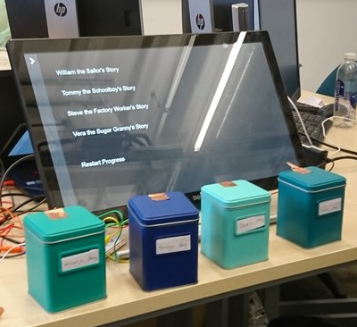
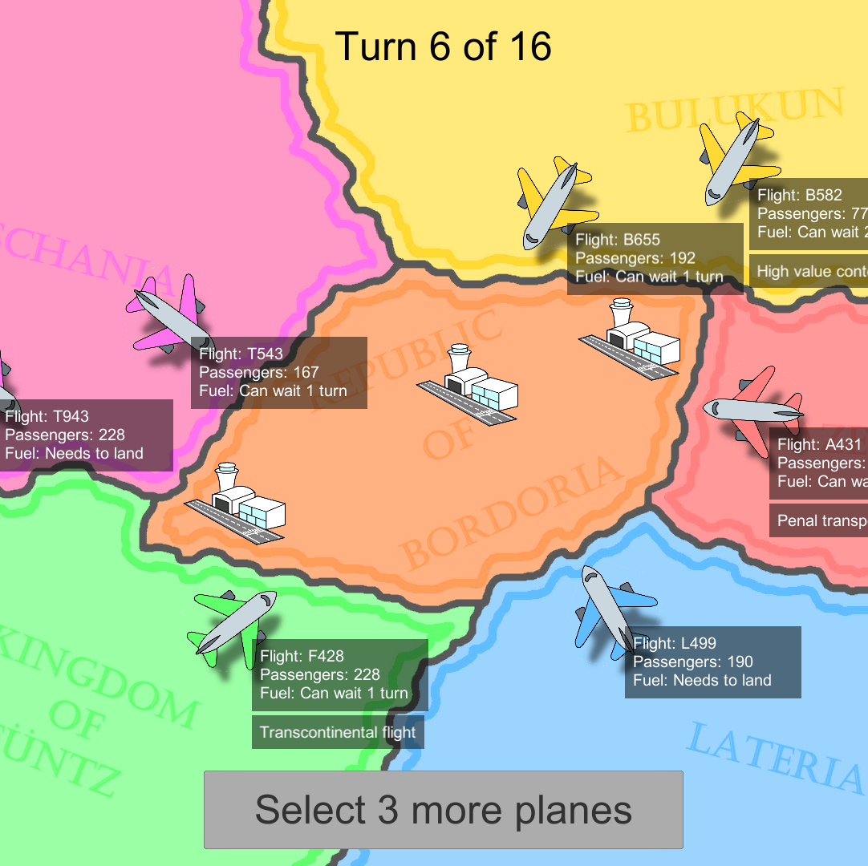
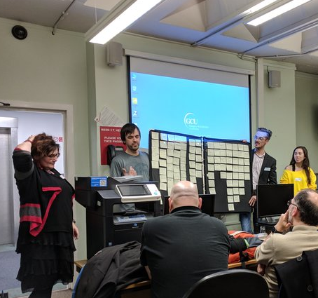
What is a Game Jam?
A biographical game with "smelling" tins
(Sensory Game Jam, 2019 – 1 week)
An air traffic control simulator
(NATS Game Jam, 2018 – 1 week)
A storyboard for game ideas
(Narrative Game Jam, 2017 – 4 hours)

Slide 5
What is a Game Jam?
We have four hours to develop what we can for our game concepts!
This can be:
Game Design (explaining how mechanics and features will work)
Artwork (hand-drawn or digital)
Sound Development (creating an audio drama that represents your game)
Prototyping (using GameMaker, Scratch, or paper to show your game working)

Slide 6
Task: Creating Your Game
As a team (or a collection of smaller teams) you are tasked with one of the following:
Option One: Complete the Game Concept sheet
Option Two: Produce Art, Audio, and/or paper prototypes for your game
Option Three: Create a playable digital version of your game (one level)

Slide 7
What Happens Next?
Share your work!
Make sure to tell your friends and family about the game you are working on – and have them play it!
Student support!
We will have two teams of game development students visiting you in the New Year and working on creating these games to be released!
Keep making!
You are at the beginning of your game-making journey, and there are more ideas and games to be made.

Slide 8
Thank You!

