Slide 1
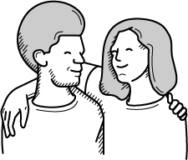
The Iceberg Theory
Seeing things from other people’s perspectives

Slide 2
SESSION AIMS
WHAT YOU WILL LEARN
To enable participants to see alternative perspectives.
To equip participants with the knowledge to help others gain a perspective on mental health

Slide 3
The Iceberg Theory
Watch the Iceberg Theory video
Notes:
Play video to 1 minute 10 seconds -https://www.youtube.com/watch?v=ye7TVMl-_TQ

Slide 4
How much of an iceberg can we see?
Answer: About 9%

Slide 5
Behaviours
If someone is struggling, what behaviours might we see?
What are some possible things that could happen in someone’s life to cause these?

Slide 6
Underneath the iceberg…
What might be at the bottom of the iceberg underneath the water that contributes to the type of person you are?

Slide 7
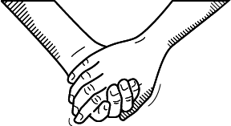
Underneath the iceberg…
What are the basic needs of human beings?

Slide 8
The Iceberg Theory
"Empathy develops when the individual, group or community have the strength to see beyond the destructive expressions of anger; to the hurt, the needs and fears of those who they experience as hurting them."

