Slide 1


Lost in Translation?
Sharing terminology between youth workers & teachers
Notes:
This is a front cover page and can only be used once. Use the corresponding blue internal and back pages if you are using this page. You may add a title and a subtitle if needed only. Do not add anything else or move elements around.

Slide 2
Reaching a shared understanding
Whose role is it? - A quick quiz
For Scotland's learners, with Scotland's educators

Slide 3
Whose role - youth work, schools, or both?
Whose role is it to support the development of skills for learning, skills for life and skills for work?
Whose role is it to engage with families and communities?
Whose role is it to deliver Curriculum for Excellence?
Whose role is it to support the health and wellbeing of children and young people?
Whose role is it to track and monitor the achievements of children and young people?
Whose role is it to raise attainment?
Whose role is it to close the poverty-related attainment gap?
Whose role is it to assist children and young people to recognise, realise and defend their rights?
Whose role is it to engage with children and young people who choose to participate in community activities?
Whose role is it to report to parents/carers about the progress of children and young people?
For Scotland's learners, with Scotland's educators
Notes:
Facilitator should ask the questions in turn. Participants can ‘vote’ either using Mentimeter, show of hands etc
Facilitator can invite participants to explain their answers
Whose role is it to support the development of skills for learning, skills for life and skills for work?
Whose role is it to engage with families and communities?
Whose role is it to deliver Curriculum for Excellence?
Whose role is it to support the health and wellbeing of children and young people?
Whose role is it to track and monitor the achievements of children and young people?
Whose role is it to raise attainment?
Whose role is it to close the poverty-related attainment gap?
Whose role is it to assist children and young people to recognise, realise and defend their rights?
Whose role is it to engage with children and young people who choose to participate in community activities?
Whose role is it to report to parents/carers about the progress of children and young people?

Slide 4
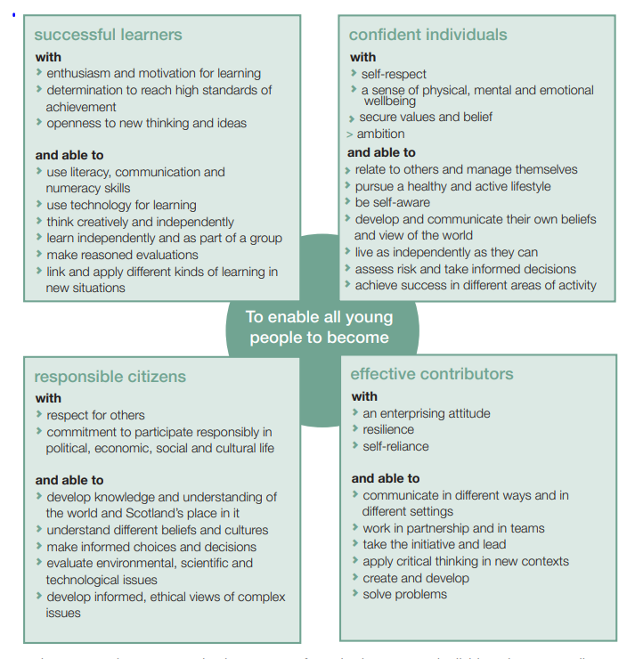
Key messages from CfE
The principles of Curriculum for Excellence
Challenge and enjoyment
Breadth
Progression
Depth
Personalisation and choice
Coherence
Relevance
For Scotland's learners, with Scotland's educators

Slide 5
CfE Entitlements
All children and young people are entitled to experience;
A coherent curriculum from 3-18
A broad general education, including well planned experiences and outcomes across all the curriculum areas. This should include understanding the world and Scotland’s place in it and understanding of the environment
A senior phase which provides opportunities for study for qualifications and other planned activities for developing the four capacities
Opportunities for developing skills for learning, skills for life and skills for work
Opportunities to achieve to the highest levels they can through appropriate personal support and challenge
Opportunities to move into positive destinations beyond school.
For Scotland's learners, with Scotland's educators

Slide 6
Key messages from building the curriculum 4- skills for learning, skills for life and skills for work
1. The development of skills is essential to learning and education to help young people to become successful learners, confident individuals, responsible citizens and effective contributors. The skills and attributes which children and young people develop should provide them with a sound basis for their development as lifelong learners in their adult, social and working lives, enabling them to reach their full potential.
2. All children and young people are entitled to opportunities for developing skills for learning, life and work. The skills are relevant from the early years right through to the senior phase of learning and beyond.
3. The skills should be developed across all curriculum areas, in interdisciplinary studies and in all the contexts and settings where young people are learning. They have been embedded into the Curriculum for Excellence Experiences and Outcomes. As such they are the responsibility of all pre-school, school and college staff, professionals and adults working with children and young people. It will be important to recognise and reflect the important role of parents and carers in influencing young people.
4. Progression in skills is signposted in the Experiences and Outcomes. This will help practitioners to ensure that as they progress through the levels, learners build on, extend and apply similar skills developed at previous levels.
For Scotland's learners, with Scotland's educators

Slide 7
Key messages from building the curriculum 4- skills for learning, skills for life and skills for work
5. Curriculum for Excellence is firmly focused on the learner. Opportunities to develop skills may be offered in different ways appropriate to learners’ needs. The opportunity to engage in active learning, interdisciplinary tasks and to experience learning in practical contexts is important in enabling all children and young people to develop, demonstrate and apply a wide range of skills.
6. It is important that children and young people are aware of, and understand, the value of the skills that they are developing. Adults, practitioners and learners should reflect together on their progress in the range of skills that they consider to be important in their learning, lives and work.
7. The assessment process should help children and young people to understand why skills are important, reflect on how they are developing their skills, identify the next steps in their skills development and understand how the skills they have acquired can be used across the curriculum and in their lives in and outside the classroom or establishment.
8. Every child and young person is entitled to support to enable them to gain as much as possible from the opportunities to develop their skills which Curriculum for Excellence can provide. Timely provision of support to meet individuals’ needs will enable children and young people to effectively engage with opportunities for skills development.
9. Curriculum for Excellence can best be delivered through partnership working. All establishments should work with partners and share a common understanding and language around skills development and application. Together, they should plan and deliver learning and other experiences which meet the needs of individual children and young people.
For Scotland's learners, with Scotland's educators

Slide 8
Learning Resource 8: Personal Learning and Achievement
Personal learning and achievement is recognised as an integral part of the learning experiences throughout children and young peoples’ education. The term is used to encompass all learning and achievements both within and outwith formal education.
As a result of engaging with this learning resource you will:
  gain a broader understanding of what is meant by personal learning and achievement
  be able to reflect on your current practice by considering personal learning and achievement in a variety of contexts and forms
  be able to consider the development, monitoring, tracking and recording of children and young people’s personal achievements, both in school and in their communities.
  gain an understanding of the partnerships and resources that are available to support wider learning and achievement in your context, with a particular focus on the contributions of Community Learning and Development practitioners.
Personal Learning and Achievement Wakelet and ES Resource
For Scotland's learners, with Scotland's educators

Slide 9

Links
Building the Curriculum 4 Skills for learning, skills for life and skills for work
UN Convention on the Rights of the Child UNCRC
Personal Learning & Achievement - Wakelet

Slide 10


Reaching a shared understanding:
The role of youth work

Slide 11
Youth Work
Part of Community Learning and Development
An education practice – non-formal learning
Youth work roles in third sector, community-based youth work, local authority CLD services
Diverse settings
Numerous approaches

Slide 12
Role of a youth worker
Support personal, social and educational development of young people.
Engage with communities to promote the voice and needs of young people
Encourage engagement of young people in their community
Promote the rights of young people
Promote inclusion, equity and the valuing of diversity
Engage with young people to promote their emotional wellbeing and mental health
Initiate, build and maintain relationships with young people
Enable young people to identify, reflect and use their learning to enhance their future development
Assist young people to learn and engage with the youth work process
Assist young people to recognise, realise and defend their rights
Notes:
Part of CLD

Slide 13
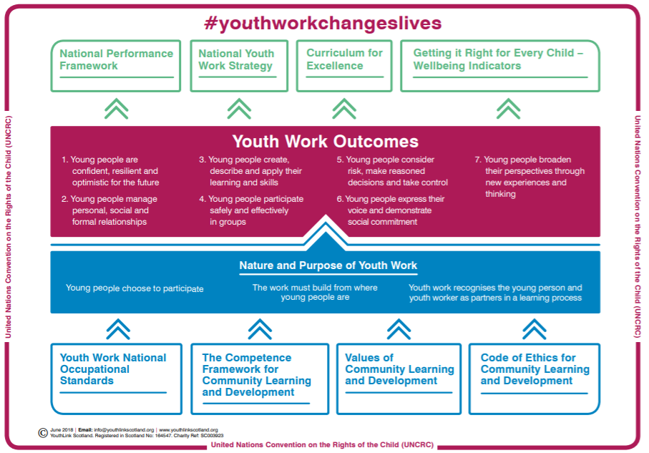

Slide 14
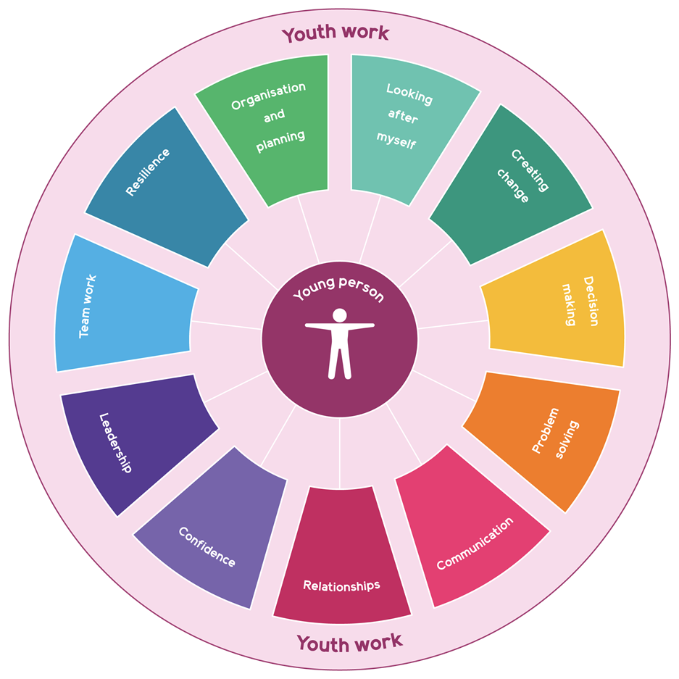
Development of skills for learning, skills for life and skills for work
Young people develop a wide range of valuable skills in a variety of youth work contexts. These skills equip young people to live, learn and work, helping them to thrive and fulfil their potential.
The key skills that young people can develop though participation in youth work in Scotland and how these contribute to Curriculum for Excellence and the world of work.
Youth work provides opportunities for young people to develop, recognise and articulate their skills. This supports learner profiling, helping young people to profile across contexts and settings.
Notes:
In working towards these outcomes, young people develop skills for learning, skills for life and skills for work

Slide 15

Skills across the curriculum
The development of skills is essential to learning and education to help young people to become successful learners, confident individuals, responsible citizens and effective contributors.
All children and young people are entitled to opportunities for developing skills for learning, life and work.
The skills should be developed across all curriculum areas, in interdisciplinary studies and in all the contexts and settings where young people are learning.
It is important that children and young people are aware of, and understand, the value of the skills that they are developing…across all stages and settings, including in the wider community.
Different contexts for learning provide opportunities and motivation for learners to develop associated skills, for example, through experiences of the world of work, including enterprise and entrepreneurial activity, citizenship or out-of-school learning.
All establishments should work with partners and share a common understanding and language around skills development and application.

Slide 16

Delivering CfE: Personal achievement
“Curriculum is defined as the totality of all that is planned for children and young people from early learning and childcare, through school and beyond. That totality can be planned for and experienced by learners across four contexts”
CfE Refreshed Narrative

Slide 17
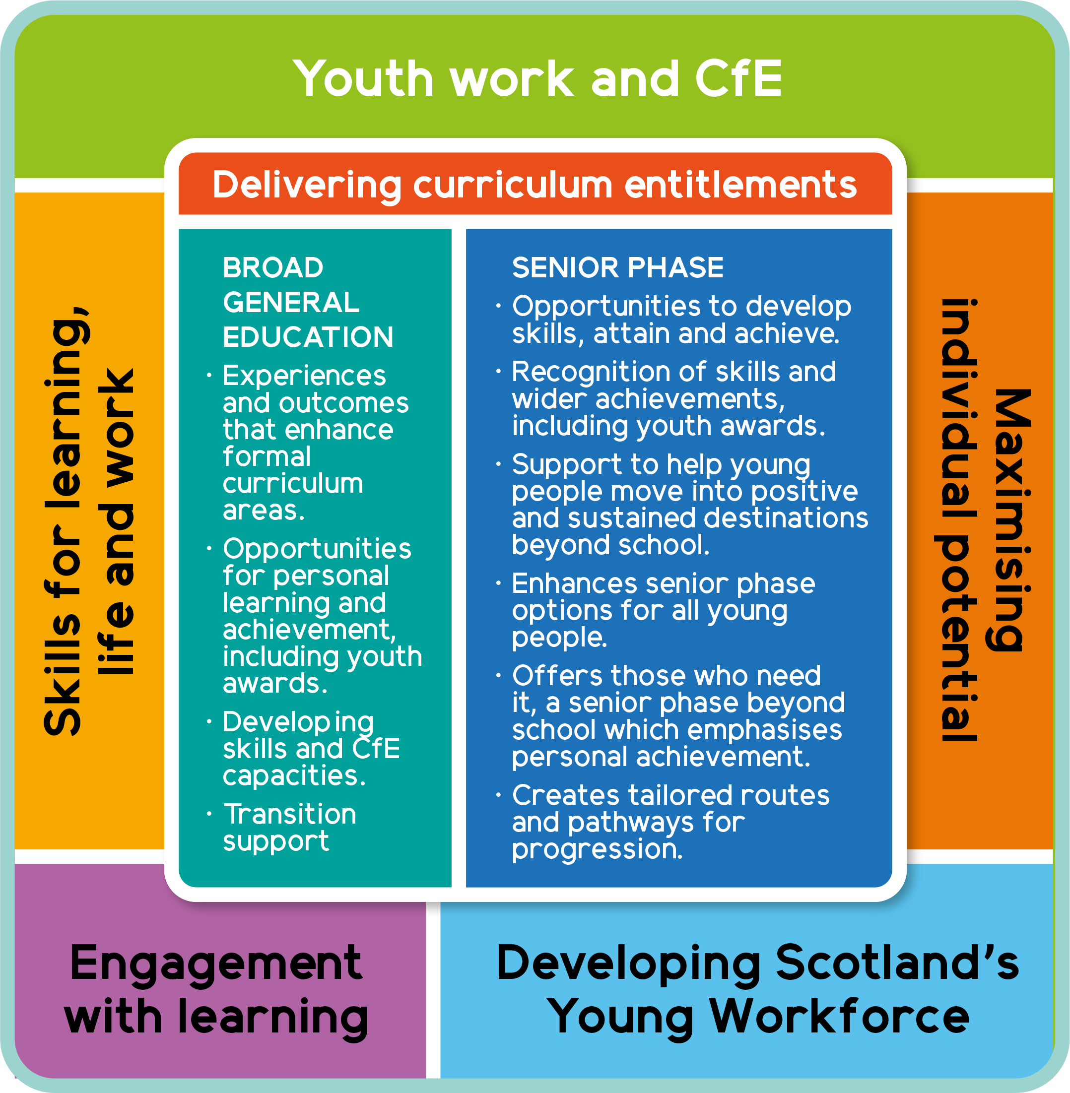
Delivering CfE
Youth work is part of the education system, delivering CfE across communities and schools.
Youth workers plan and deliver non-formal learning opportunities, helping children and young people to develop the skills and attributes they need to thrive.
This complements and enhances learning through the formal curriculum, maximising individual potential with appropriate support and challenge.
For some young people, youth work is the key to unlocking learning, overcoming barriers to engagement and providing a more tailored curriculum offer.
Youth Work and CfE

Slide 18
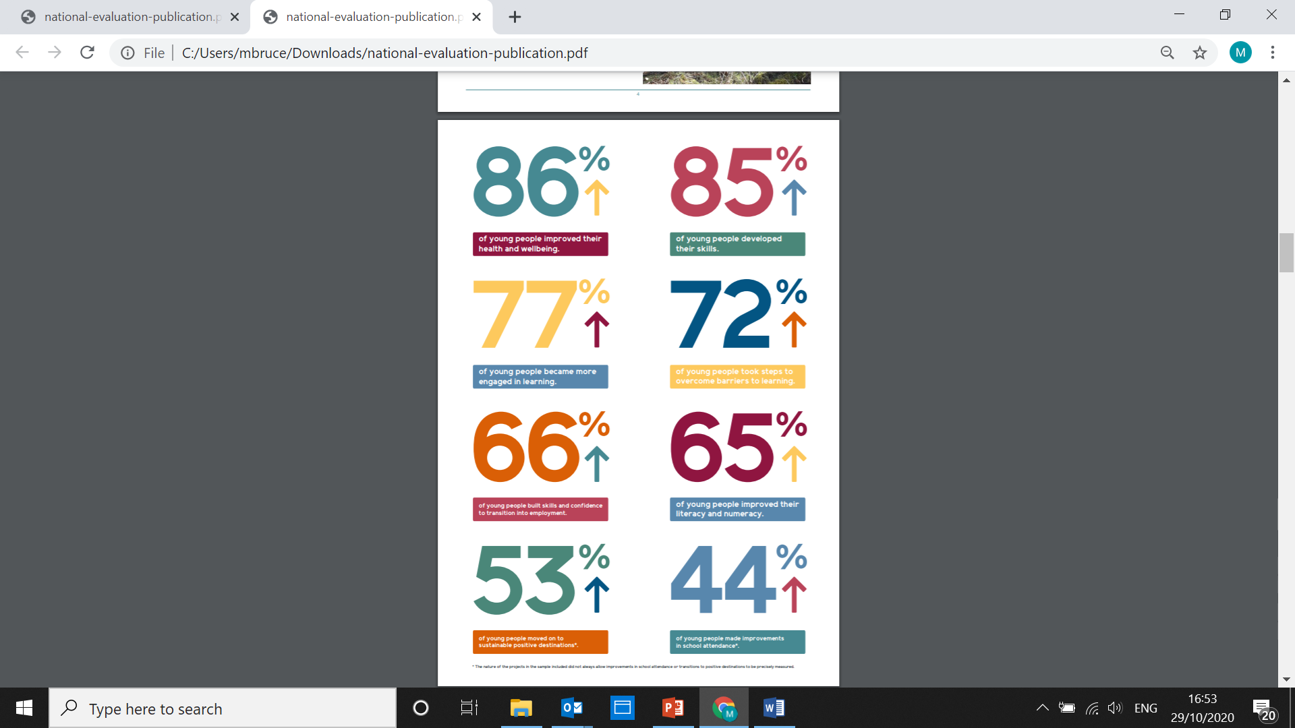
Closing the poverty-related attainment gap
YLS National case study evaluation 2020 – robust evidence that youth work contributes to closing the poverty-related attainment gap – developing skills, improving health and wellbeing, improving attendance and engagement in learning and helping young people move into positive sustained destinations post school.
Helping children and young people to develop the skills and attributes they need to thrive.

Slide 19
Lost in Translation?
Sharing terminology between youth workers & teachers
Myths?
There are only a couple of awards that young people can get outside of school.
Youth awards are only valuable to schools if they attract Insight tariff points.
Community planning is for CLD and does not involve schools.
Pupil Equity Funding can’t be used for interventions that take place out-with term-time or for community-based interventions.
Youth work is about playing table tennis and hanging about with your pals.
The National Youth Work outcomes have nothing to do with Curriculum for Excellence.

Slide 20

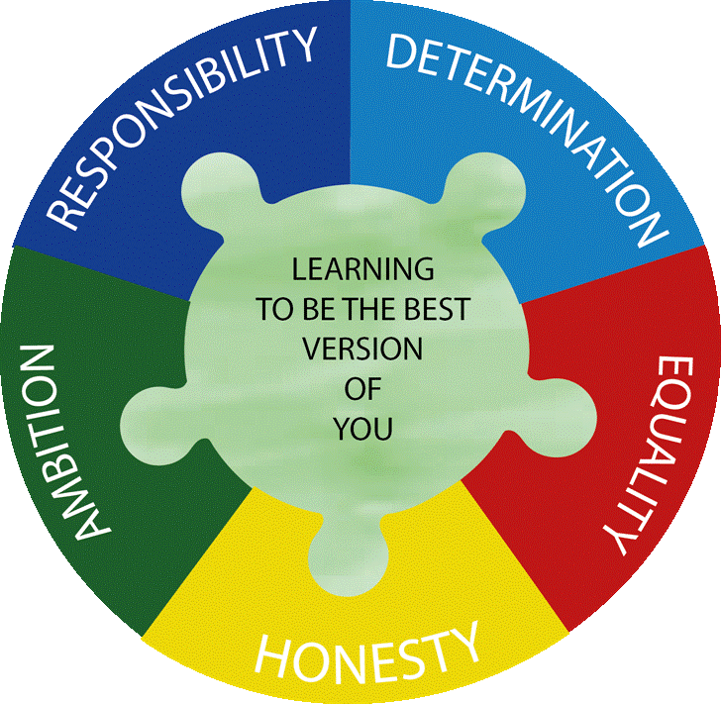
Hawick High School
Sharing Terminology between
Youth Work and Education

Slide 21
Our context
Roll approx. 820 students
Over 30% young people live in SIMD bands 1 or 2
Only secondary SAC school in Scottish Borders Council
Rural location
Attainment below virtual comparator

Slide 22
Our journey: a starting point
At point of joining 2 Headteachers in as many years
Staff morale very low
Very few staff had understanding of impact of ACES on young people and their readiness to learn
Some young people unable to engage in lessons… disruption in school
Young people not trusting of staff and sought validation from their peers… this resulted in negative cycle of behaviour …. ‘Gang Culture’
  Low attainment
  Poor attendance
  Positive destinations figures low for vulnerable young people

Slide 23
Our journey: a solution
Recognition that school needed to adapt its approach to young people in order to develop trust between them and adults
Need to develop inclusive practices across the school
Employment of Inclusion Officer (background CLD) and Youth Workers to engage with and support most vulnerable young people in the school….
  A different type of relationship with young people
  Shared language with young people
  Breaking down barriers between adults and young people

Slide 24
Our journey: a solution
Training for all staff:
  ACEs and their impact on young people
  Pivotal and then Nurture training
  Development of Integrated Student Support; shared understanding of approaches to supporting young people with SEBNs
  Unconditional positive regard for all young people

Slide 25
Our journey: what are we doing?
  Established a Nurture Base
    a place where young people feel included and are accepted as individuals, focusing on where the young people are at…
    provided with opportunities to develop the skills and self awareness to engage with learning in mainstream setting
Identifying need
  transition planning and Boxall profiling to identify barriers to learning
  selecting and developing targeted interventions to ensure that young people are supported appropriately
  Sharing successful interventions and achievements with teaching staff… Nurture News

Slide 26
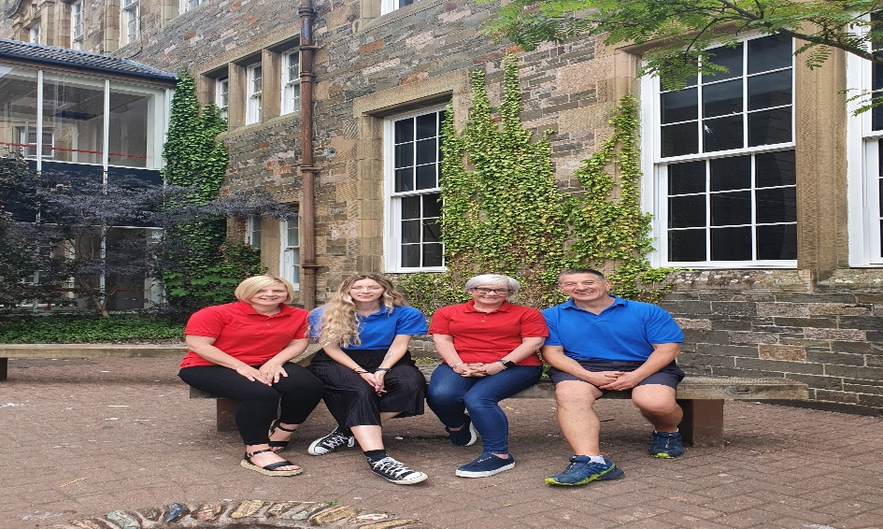
Role of Youth Worker
1 to 1 support
Support within mainstream classes (short term)
Link between young person and teacher
Facilitate Breakfast and Lunch clubs.
Support with enhanced transitions
Outreach work
Groupwork e.g. Dynamic Youth Award
Success@Arithmetic,
Support out with term time
Contact with home/ door stop visits during
holidays and both Covid 19 Lockdowns.

Slide 27
Our journey: Aleesha’s story

Slide 28
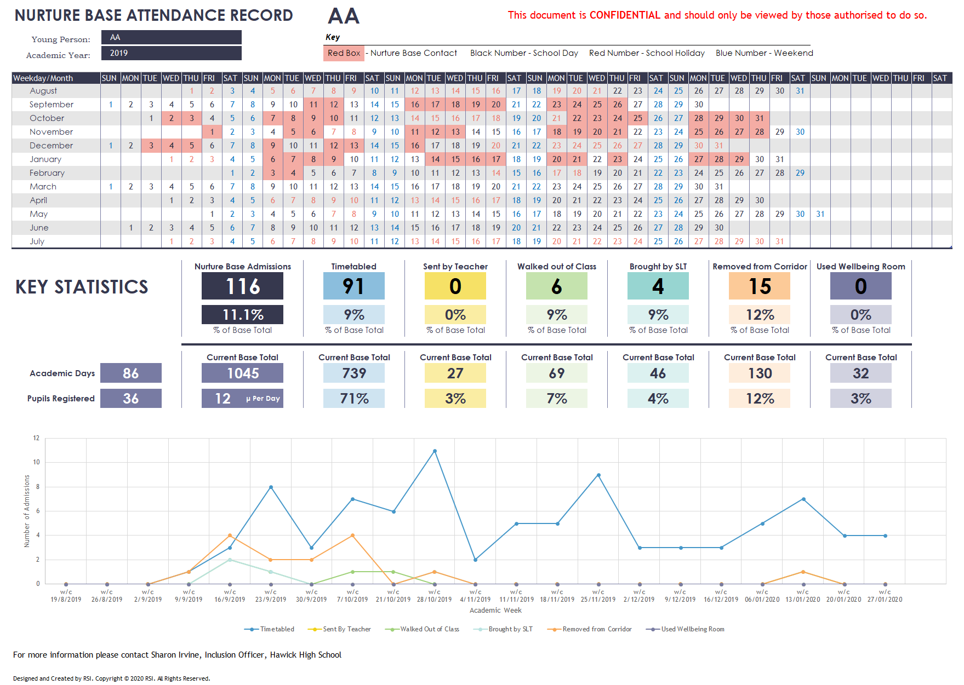
Our journey: tracking progress

Slide 29
Our journey: tracking
Attendance Tracker provides key statistical data to facilitate effective joint planning of both individual and wider student cohorts.
Attainment and achievement tracking of all young people with barriers to learning;
  Particular focus on 5 qualifications
  Wider achievement opportunities
Boxall profiling is used to track the cognitive development and behavioural traits of young people through their education. Understanding what lies behind their behaviours has proven helpful for all involved. By sharing individual targets with teachers we are better able to support our young people.

Slide 30
What has the impact been so far?
Increase in general attendance to school
More young people engaging in mainstream classes
Increased number of pupils leaving school with 5 qualifications
Increased number of young people entering into positive destinations as they leave school: 95%
Strengthened relationships between teaching and youth work staff.

Slide 31
Our Journey: Next Steps
Continue with Nurture Training to all staff
  Inclusive practice evident in all areas of the school
Roll out of Family Learning programme working in partnership with CLDs
  Provide support for targeted S1 young people and their families
  Family engagement with learning in school
  Better partnership working with vulnerable families

Slide 32
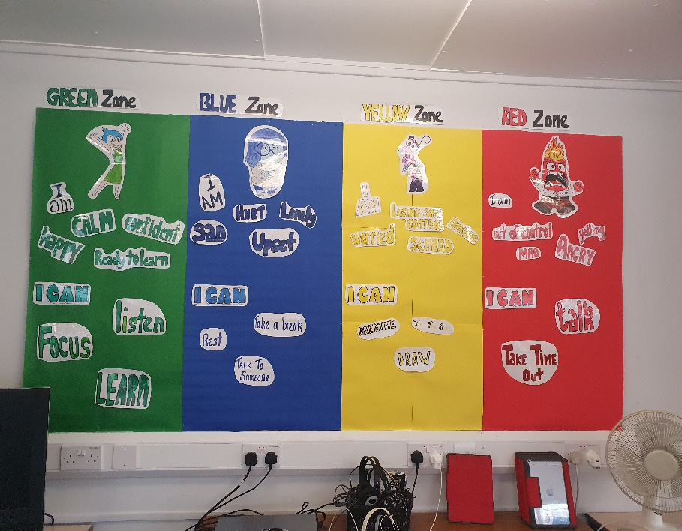
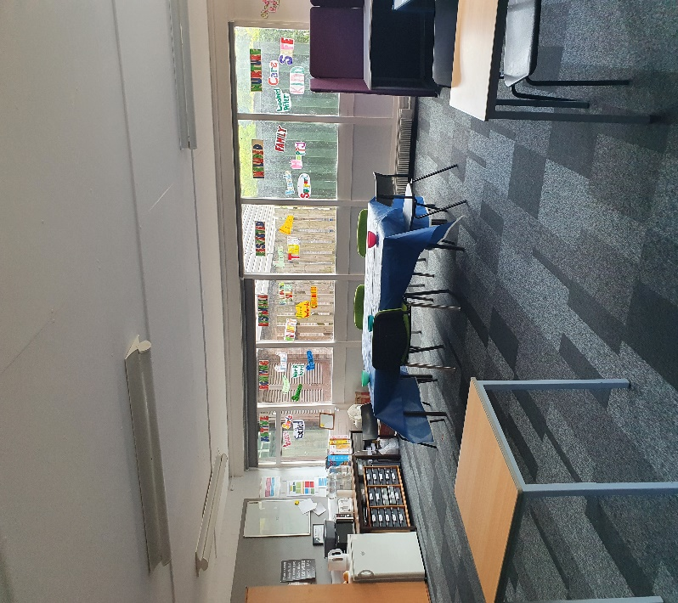
Any Questions?

