Slide 1

Scotland’s Climate Change
Trusted Messengers Support Pack
August 2025

Slide 2
Contents
1) Introduction
  Purpose of this pack
  What is a trusted messenger?
2) How to engage your audience on climate change
  Our vision, strategic objectives & principles of engagement
  Methods of engagement & participation
  Eco-distress
  Scotland's Climate Survey
  The COM-B Model
  Resources to build climate literacy
  Accessibility & inclusivity
3) Support for trusted messengers
  Amplifying your work – Scotland's Climate Week, NetZeroNation website & social media
  Financial support – Climate Engagement Fund
  Local support – Climate Action Hubs
  Children and Young People – Climate Action Schools
  Adaptation Scotland
  Participation – Climate Policy Engagement Network & Participation Programme
4) Scottish Government climate policy
  Scotland’s net zero ambitions
  Scottish Government climate change policies
5) Contact us

Slide 3
Section 1:
Introduction

Slide 4
Purpose of this pack
We aim to work together with a range of organisations in Scotland to engage the public, building understanding and encouraging action on Climate Change. Our approach is set out in the Public Engagement Strategy for Climate Change
The purpose of this pack is to provide information and support to ‘trusted messengers’ to effectively speak to their audience about climate change.
This pack has been developed by the Scottish Government Climate Change Public Engagement team to outline the different opportunities for support available to stakeholders and partners.
The pack will be reviewed regularly, to ensure the information contained is up-to-date and relevant.
Please get in touch with questions and enquiries at ClimateChangeEngagement@gov.scot

Slide 5
What is a trusted messenger?
There are many local, regional and national organisations that are often the most effective climate change communicators – or ‘trusted messengers’. We want to work with and support these trusted messengers to more effectively engage their audiences on climate change in order support people to take climate action and empower them to engage on climate issues.
Who are the trusted messengers?
The definition is broad. The Public Engagement Strategy for Climate Change describes them as “individuals and organisations working to engage the public, from small local groups up to stakeholders delivering national campaigns.”
We broadly define trusted messengers under the following four categories:
  Place-based messengers (e.g. local government, community/voluntary groups)
  Sectoral and institutional messengers (e.g. schools, sports clubs, science centres)
  Equality-based messengers (e.g. gender and age advocacy groups)
  Influencers (e.g. climate scientists, national figures)
Do you have an audience you could work with on climate change engagement?

Slide 6
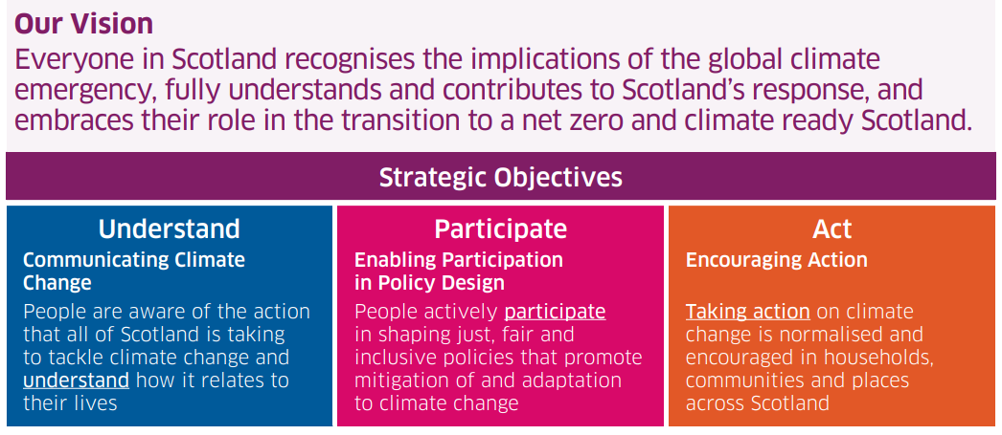
Our vision for climate public engagement

Slide 7
Public Engagement Strategy and Mid-Point Review
Everyone in Scotland has a role to play in responding to climate change.
Scottish Government supports a people-centred approach to climate policy.
Our engagement involves a mix of methods to reach public audiences - we deliver mass communications, support community-led action, enable people to participate in policy development, and work with trusted messengers to reach out to new audiences.
Mid Point Review
In April 2025 our Mid-Point Review of the Public Engagement Strategy was published.
It summarises activities and impacts between 2021-2024, reflects on our overall approach, and identifies ways to improve delivery.
An independent review of international evidence on public engagement with climate change was also delivered. This research highlights key methods and best practice for climate engagement with the public.

Slide 8
The Stats - Scotland's Climate Survey
About the Survey
In 2024, the Scottish Government, through ClimateXChange, commissioned Ipsos to conduct a new nationally representative survey of Scottish adults aged 16 and over.
The aim was to generate reliable estimates of Scottish adults’ awareness, understanding and experiences of climate change-related issues.
More than 4,000 adults across Scotland shared their views on a range of climate-related issues, including transport, nature, preparing for the impacts of climate change and home energy.
Key Statistics
Almost three-quarters of those surveyed (72%) feel climate change is an immediate and urgent problem and almost all households have experienced a severe weather event in the past 12 months.
46% feel worried about climate change; 11% say it affects them negatively most of the time.
Almost half (44%) of Scots think that reaching net zero by 2045 would improve their quality of life – compared to just 1 in 10 who think it would make it worse.
A third of households (33%) were finding it difficult to afford their energy bills whilst more than four in ten (42%) said they were having to cut back spending on food and other essentials to spend more on energy bills.
Most households reported that they had experienced storms and strong winds (89%), extremely heavy rain (79%) or very low temperatures, snow and ice (56%) in the last 12 months.
Results of the survey can be seen here: Scottish Climate Survey: main findings - gov.scot

Slide 9
Section 2:
How to engage your audience on climate change

Slide 10
Principles of engagement
Our strategy suggests that climate engagement activity should aim to follow these seven guiding principles:
Our approach will be inclusive and accessible to all
Our approach will put people first and place people at the heart of all that we do
We will listen to and engage with experts to ensure an evidence-based approach
Climate justice and a just transition will be embedded within our approach
We will continue to encourage a participative society with two-way dialogue on climate change
We will take a positive approach that outlines a vision for climate action that promotes the many benefits
We will be open and transparent to make sure people can see and understand our actions

Slide 11
Methods of engagement & participation
There are many frameworks, theories and strategies for public engagement, and there is no one-size-fits-all approach. We encourage you to think about the ways you currently interact with your audience, what works best with them, and explore new ways of communicating and encouraging participation.
Spectrum of participation
There are different levels of participation, from informing your audience (one-way dialogue) to genuine collaboration (two-way dialogue). Use the table on the next slide to think about how you engage with and involve your audience in your work, and if there are opportunities to try different methods of engagement.
Facilitation
Good facilitation skills are the cornerstone of productive discussions, engagement activities and teamwork. There are trainings and support available for this, see for example Seeds for Change facilitation guidance.
Resources
Participatory democracy and digital participation platform guide from People Powered
Scottish Communities Climate Action Network trainings and support
Scottish Community Development Centre trainings

Slide 12
Spectrum of participation
Level of engagement | Purpose | Offer to participants
Inform | ● to provide the public with balanced and objective information ● to inform those with an interest in the outcome (i.e. stakeholder groups) | ● we will keep you informed ● we will provide information openly and transparently ● we will not withhold relevant information
Consult | ● to obtain feedback on analysis, alternatives, proposals and/or decisions ● to inform those making the decision or developing proposals | ● we will keep you informed ● we will listen to and acknowledge your concerns and aspirations ● we will give serious consideration to your contributions ● we will be open to your influence ● we will provide feedback on how your input has influenced the outcome
Involve | ● to work directly with participants throughout the policy- or decision-making process, ensuring their concerns and aspirations are understood and considered ● to enable participants to directly influence the decisions or options developed | ● we will keep you informed ● we will work with you to ensure that your concerns and aspirations are directly reflected in the outcomes or alternatives developed ● we will provide feedback on how your input has influenced the outcome
Collaborate | ● to partner with participants in each aspect of a decision, including defining the issue, developing alternatives and identifying preferred solutions ● to share the development and decision-making process as much as possible | ● we will look to you for advice and innovation in formulating solutions ● we will incorporate your advice and recommendations into decisions or implementation to as far as possible
Delegate | ● to place final decision making in the hands of the participants ● to hand over the ability to make decisions and/or take action | ● we will implement what you decide

Slide 13
Eco-distress
As people learn about and face up to the risks and impacts of climate change, they are more likely to experience difficult and uncomfortable emotions.
These feelings are understood by climate psychologists to be appropriate responses – they are a sign that a person is in touch with the severity of the climate emergency.
Such emotional responses are also common, with studies showing a significant portion of adults and young people experience feelings of distress in relation to the environmental crisis.
We know that taking action can help mitigate feelings of eco-distress. It is important to deal with distressing emotions in a healthy way, because chronic emotional stress and suppression of emotions over the long-term can have negative impacts on health and wellbeing and can undermine people’s capacity to get to grips with the climate emergency.
Resources:
Climate Psychologists recordings on climate distress for adults and children
Climate Psychology Alliance Scotland resources (handbook and podcast). CPA also offers a monthly support space for youth.
Digital education resource for teachers to think critically about the impact of the Climate Emergency
Childline toolkits
AyeFeel campaign by YoungScot, including info on understanding climate anxiety
Good Grief network resources

Slide 14
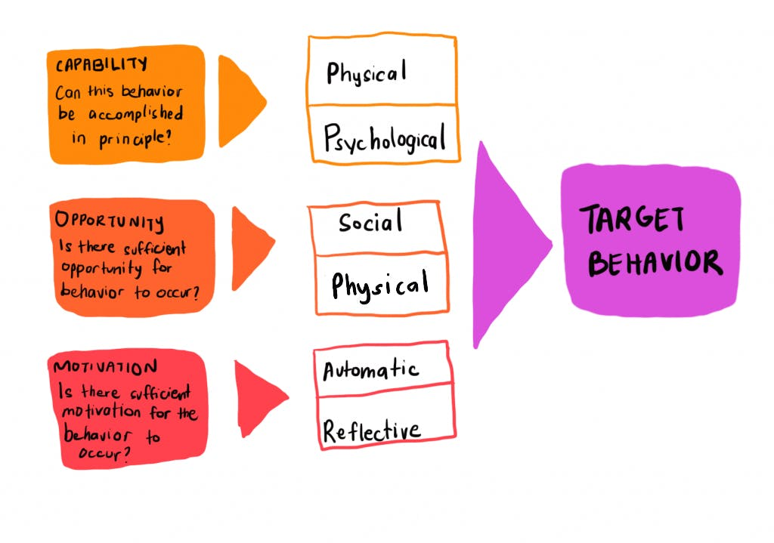
Encouraging Climate Behaviour - The COM-B Model
What is the COM-B Model?
COM-B stands for Capability, Opportunity, Motivation and Behaviour.
It is a tool that shows us that for someone to change their behaviour, they must have the capability, opportunity and motivation to do so.
Using COM-B
As a starting point, you must identify the behaviour that you want to target. This could be something like ‘travelling more frequently by public transport’. And then it is important to decide who you would like to encourage to take that action. For example, Commuters. Therefore, the behaviour you are looking to target is ‘commuters to travel more frequently by train’.
You can then work through the COM-B model by identifying what barriers commuters might face when engaging with this behaviour under the 3 categories presented above. This can help in understanding what might be preventing someone from taking action and can support in designing appropriate interventions.
Resources - The COM-B Model for Behavior Change - The Decision Lab

Slide 15
Resources to build climate literacy
Carbon Literacy Project
The Carbon Literacy Project offers a one-day, certified, and widely recognised training in carbon literacy.
  Toolkits for different sectors, trainer manuals, train the trainer, and other support available – mostly free or low cost.
Keep Scotland Beautiful, Royal Scottish Geographical Society, Scottish Communities Climate Action Network, Highlands and Islands Climate Hub and SCVO all run different types of carbon and climate literacy trainings for different audiences across Scotland.
Place Standard Tool with a Climate Lens
The Place Standard with a climate lens is a tool to help people to understand how climate change might play out in a local area and support them to design their future place in mind.
Explaining Climate Change
The Scottish Government has developed two short videos explaining what climate change and net zero is on a basic, introductory level. This is to build climate literacy and encourage further climate action.
What is climate change?
What is net zero?

Slide 16
Resources to support Children and Young people
Children and Young People resources
The Scottish Government contributes to the Young Scot website which provides young people with: information on how to take climate action; opportunities to get involved in climate conversations; and advice for dealing with climate anxiety. 2.
The Scottish Government ParentClub website contains materials to support parents in speaking with younger school age children about climate change.
The Scottish Government supports Climate Action Schools. Their website has all the Climate Action Schools Resources - including a library of lesson plans, activities, videos and experiments to support learning for sustainability.
The Scottish Government supports Keep Scotland Beautiful, who have created a Youth Climate Emergency Toolkit
We have children's version of the Scottish National Adaptation Plan, which tells children and young people how Scotland is preparing for the effects of climate change.
Children’s Parliament resources
Children’s Parliament worked alongside Scotland’s Climate Assembly and launched the Climate Changemakers project, offering resources for children to learn about climate change and how to get their voices heard.

Slide 17
Engaging Accessibly, Inclusively & Climate Conversations
We have developed an accessibility and inclusivity checklist for engagement. This is not intended to be an exhaustive guide to inclusivity and accessibility, but rather starting point with additional resources built in.
What is the checklist for? It is for trusted messengers to use when planning engagement on climate change (e.g. in-person, online or hybrid events and other communications & resources). The resource walks people through the variety of accessibility and inclusivity considerations that should be taken into account when planning engagement work.
The checklist can be downloaded here (double click on icon):
Climate Conversations
It doesn’t have to be hard to have a conversation about climate change. The Scottish Government has developed a climate conversations pack to help start these important conversations. The pack contains facts about climate change and discussion starters. Climate Conversation Pack | Net Zero Nation

Slide 18
Section 3:
Support, Resources & Networks

Slide 19
Amplifying your work – Scotland’s Climate Week
Scotland's Climate Week
Scotland's Climate Week is an annual series of events to highlight the importance and urgency of tackling climate change and celebrate all the positive climate action being taken across the country to help inspire further collective, transformative change.
Usually starting on the last Monday in September, Climate Week has been delivered annually since 2016 and has grown from an internal Scottish Government programme to now include a huge spectrum of organisations and individuals from across Scottish society. Read more: Climate Week | Net Zero Nation
If you’re planning to run an event during Climate Week and are interested in inviting a member of Scottish Government, or for further information, please get in touch via email at ClimateChangeEngagement@gov.scot.
Use #ScotClimateWeek to highlight your participation on social media.

Slide 20
Amplifying your work – communications and social media
Net Zero Nation is the Scottish Government’s “one stop shop” website for individuals, communities and organisations looking for information on what they can do to address the climate emergency. It contains:
up-to-date info about climate change & the actions that Scottish Government is taking to tackle it;
advice on the actions that people and communities can take in their own lives; and
blogs that highlight climate action across the country.
Please get in touch if you want to contribute with a blog post.
The website also has resources available for your organisation, including resources for businesses, resources for communities, and our Climate Conversations Pack. You can also sign up to receive our newsletter.
We are also active on several social media platforms, using the hashtag #LetsDoNetZero
LinkedIn: Net Zero Scotland
Facebook: @ScotGovNetZero
Instagram: @ScotGovNetZero

Slide 21
Grant Funding
Climate Engagement Fund (CEF)
Aims:
Our Climate Engagement Fund is working with people not previously involved in climate action to deepen their understanding of climate change, explore how it affects their lives and communities, and equip them with knowledge and skills to take action.
Delivery:
The Fund achieves this via grants to ‘trusted messenger’ organisations to work with their audiences. This is annually awarded through a highly competitive bidding process.
Since its inception in 2023, the CEF has provided over £800,000 of funding to 16 climate engagement projects, with a further £275,000 allocated for 8 projects in 25-26.
In 24-25 projects reached over 7,000 people, with thousands more reached through a podcast and social media activity.
Further information about the projects funded and information on applying to the fund can be found on our website Climate Engagement Fund - gov.scot

Slide 22
Financial support
The following details a non-exhaustive list of potential funding opportunities to support climate change engagement activities:
Climate Engagement Fund - Scottish Government
Community Learning Exchange – Scottish Community Alliance
National Lottery Awards for All of Scotland – The National Lottery Community Fund
Climate Action Fund – Friends of the Earth
Community empowerment from Scottish Government (inc. Empowering Communities Fund and participatory budgeting funding)
Or search for funding possibilities using Funding Scotland or SSN’s Public Sector Funding Map.

Slide 23
Local Support
Climate Action Hubs
The Scottish Government supports a network of regional Community Climate Action Hubs. The network helps communities to address local priorities through impactful and positive climate action. They provide a vital framework for communities to come together, share ideas, and take collective climate action, supporting the transition to low carbon and climate resilient living.
24 regional Climate Action Hubs are in place across Scotland ensuring every area in Scotland has access to a hub and helping empower people to act in their neighbourhood.
To find out what’s going on in your area please find your local hub at: https://www.gov.scot/publications/community-climate-action-hubs-contact-details/
You can view community resources on the Net Zero Nation website.

Slide 24
Children and Young People
Climate Action Schools
Climate Action Schools, delivered by Keep Scotland Beautiful, is a framework of education initiatives to support Scotland’s educators, young people and children to progress Learning for Sustainability and climate change education.
Climate Action Schools focuses on five main outcomes: Learning for Sustainability; Climate Emergency; Biodiversity; Litter and Pollution; and amplifying Pupil Voice.
The Climate Action Schools framework of education initiatives is designed to support Scotland’s educators, young people and children to progress Learning for Sustainability and climate change education. It includes a wide range of activities for pupils, schools and educators including opportunities to share learning with schools across Scotland and internationally; professional learning and training; and engagement through arts and heritage.
Climate Action Schools has delivered continuous, national and impactful activities in support of climate education and action, to help children, young people and educators develop their climate literacy and identify opportunities to take positive climate action
In 2024-25 1,160 schools were involved in at least one Climate Action Schools activity

Slide 25
Adaptation Capacity Building
Adaptation Scotland
Adaptation Scotland provides advice and support to help Scotland be prepared and resilient to the effects of climate change.
Practical tools and guidance for communities, businesses and public bodies are available at the adaptation.scot hub.
As a trusted messenger, Adaptation Scotland bridges the gap between climate science and local action. By co-developing solutions with communities and aligning with national policy, it ensures adaptation efforts are credible, inclusive, and grounded in real-world needs.
The Community Climate Adaptation Routemap is a practical guide that helps Scottish communities plan and take action to build local resilience to climate change offering over 20 examples of practical adaptation actions, along with resources and tools for addressing climate impacts.
The Adaptation Capability Framework is a practical tool developed by Adaptation Scotland to help organizations assess, plan, and improve their capacity to adapt to climate change in a structured and strategic way.
Adaptation Scotland also supports regional partnerships, like Climate Ready Clyde and Highland Adapts, who bring together local stakeholders to develop place-based responses to climate risks, supported by tools, guidance, and collaboration.

Slide 26
Participation
Climate Policy Engagement Network
The Scottish Government has taken forward its climate change commitment within Scotland's Open Government action plan: 2021-2025 and established a network of representatives from third-sector and local government organisations.
Network members are able to participate in the delivery of climate change policy, including engagement, by providing advice, accountability and supporting transparency.
The network seeks to widen the existing pool of people regularly consulted, complement and streamline consultative processes, and use these connections to maximise opportunities to develop new options for and drive public participation and engagement.
The network is hosted through an online platform and is open to organisations or individuals across Scotland who have an audience or a skill relevant to the network and an interest in climate policy and engagement.
For more information, or if you are interested in joining, please contact ClimateChangeEngagement@gov.scot.

Slide 27
Participation
Participation Programme
The Climate Change Participation Programme (begun in December 2022) has involved a series of participative projects delivering events and engagements to gather views and ideas from people across Scotland. It has a distinct aim of encouraging wide participation in policy-making particularly from people who are likely to be significantly impacted by the net zero transition.
Impact:
Engaged 2,000+ people, including youth, rural residents, Gaelic speakers, and underrepresented groups
270+ organisations participated across sectors
Informed key policies including:
  Draft Just Transition Plans
  20% car km reduction route-map
  Scottish National Adaptation Plan (SNAP3)
Tripled engagement compared to previous adaptation planning
Strengthened capacity for deliberative engagement and expert-informed dialogue

Slide 28
Section 4:
Scottish Government climate policy

Slide 29
Scotland’s net zero ambitions – getting to zero by 2045
Scotland has put in place legislation, targets, plans and governance to reduce emissions and adapt to the impacts that climate change will have on our society and economy, and to do so in a just and fair way.
Latest data shows that Scotland’s emissions are down over 50% since the 1990 baseline – over half of the way to net zero.
Scotland is committed to a just transition to net zero, addressing climate change in a way that is fair and leaves no one behind.
We also need to build resilience and adapt to the impacts of climate change that are already locked in - our third National Adaptation Plan 2024 to 2029 describes what we and our partners are doing to respond to the impacts of climate change
Scotland is committed to tackling the twin crisis of climate change and biodiversity loss.
Read more: Climate change - gov.scot (www.gov.scot)

Slide 30
Scottish Government climate change policies
The “Update to the 2018 Climate Change Plan” (The CCPu) – published in 2020, set out our pathway to reaching emissions reduction targets over the period to 2032, detailing over 200 climate change policies.
Scottish Government are due to publish a new Climate Change Plan in 2026, detailing our pathway to emissions reduction over the period to 2040.
Carbon Budgets
Limits on the amount of greenhouse gases Scotland will emit over the coming decades have been announced as part of action to tackle climate change.
The Carbon Budgets propose five-year, statutory limits on emissions from 2026 to 2045. More information on the carbon budgets can be found here: New climate targets set - gov.scot
Since the last Climate Change Plan was finalised, we have:
Introduced a ban on the sale and supply of single-use vapes, and on the supply and manufacturing of certain problematic single-use plastic items, including single-use cutlery, plates, food containers and more;
Fully allocated the £30 million EV Infrastructure Fund, which is expected to deliver approximately 6,000 additional public charge points by 2030.
In 2023-24, we created over 15,000 hectares of new woodland, the highest for 34 years;
Brought the New Build Heat Standard into force

Slide 31
Scottish Government climate change policies
Scotland’s approach to adaptation
Climate change impacts, in Scotland and globally are becoming increasingly apparent. The effects of flooding, coastal erosion, drought, and storms are putting pressure on our economy, society, and environment. We are responding to these already determined impacts of climate change through our third Scottish National Adaptation Plan. Our five-year plan will help to protect lives and livelihoods by giving people the tools they need to prepare for – and adapt to – the growing impacts of climate change.
Just Transition
A just transition is both the outcome – a fairer, greener future for all – and the process that must be undertaken in partnership with those impacted by the transition to net zero. It is how we get to a net zero and climate resilient economy in a way that delivers fairness and tackles inequality and injustice. We have several tools to help us achieve a just transition in Scotland including: a National Just Transition Planning Framework with 8 National Just Transition Outcomes, a Commitment to Partnership Working, and a 10-year £500 million Just Transition Fund.

Slide 32
Example climate policies
Examples of some of Scotland’s current climate policies and targets are:
reducing greenhouse gas emissions through a Just Transition to a net zero economy and society, ensuring the journey is fair and creates a better future for everyone – regardless of where they live, what they do, and who they are
supporting decarbonisation in the public sector
engaging with business and industry on decarbonisation
jointly administering the UK Emissions Trading Scheme (UK ETS) alongside the UK Government, Welsh Government and Northern Ireland Executive.
delivering a just transition, by working with communities, business, industry and the people of Scotland to plan for our net zero future
This is not an exhaustive list, please see the Scottish Government climate change pages and Scotland's Plan for more policies.

Slide 33
Section 5:
Contact us

Slide 34
Contact us
Please get in touch with questions or support needs
Climate Change Engagement Mailbox
ClimateChangeEngagement@gov.scot

