Slide 1



Growing up in the online world
A Consultation & National Conversation
Partner Toolkit

Slide 2

The UK Government is inviting parents, guardians, and young people from across the UK to share their views and shape the country's next steps on children’s digital wellbeing
We need your help to maximise reach and diversity of input to the consultation and National Conversation.
This toolkit outlines:
What the consultation covers
How you can help us drive responses to the consultation
How you can help shape the National Conversation (including through hosting an event)
Key links and communications guidance

Slide 3
What we are doing and why
The Government is determined to give every child the best possible start in life - free to be children, supported to grow and able to thrive - while also equipping them with the skills, resilience and confidence they need to navigate a safe digital future.
We have launched a consultation to explore measures for keeping children safe online, building on the strong foundation of the Online Safety Act. We recognise there are strong concerns about the potential “addictiveness” of social media, the impact on children’s mental health and wellbeing, and new and emerging online harms. We also acknowledge there is not an agreed consensus on how best to tackle these issues.
Alongside the consultation, we want to have a National Conversation: a programme of engagement activity, running alongside the formal consultation, to engage children, parents and carers, civil society, teachers, industry and other groups, and make sure we hear from as many people as possible.

Slide 4
What the consultation covers
The consultation runs from Monday 2 March to Tuesday 26 May and seeks views on measures including:
whether there should be a minimum age for social media, and if so, what age would be right
whether platforms should be required to switch off addictive features that keep children hooked late into the night - like infinite scrolling and autoplay
whether mandatory overnight curfews would help children sleep better and what age they should apply to
whether children should be able to use AI chatbots without restriction
how age verification enforcement should be strengthened
how to help children and parents navigate the digital world and thrive online

Slide 5
How you can help
You can help us to:
Reach more people, in more places
Gather a wider range of experiences
Maintain momentum and participation in a major public issue
By:
Encouraging your trusted local and community networks to respond to the consultation and participate in the National Conversation
Amplifying our communications and the routes to take part

Slide 6


Encourage responses to the consultation

Slide 7
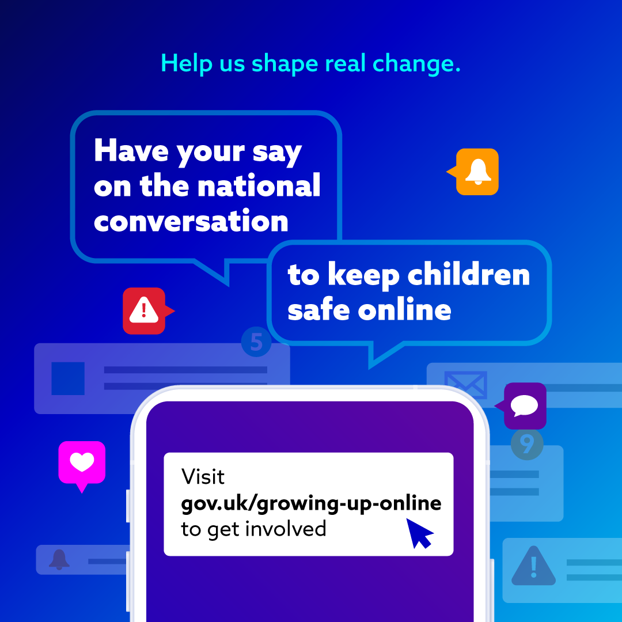
Links to the consultation
The consultation is available on GOV.UK and you can choose which sections are most relevant to you.
Parents, carers and young people each have a dedicated version of the consultation designed to be straightforward to complete.
Main consultation
Child‑friendly version
Parent‑friendly version
The consultation closes on Tuesday 26 May.
The consultation sits alongside the government’s wider approach to online safety, including a new campaign and website that provides practical support that parents can use immediately, giving them the confidence they need to have conversations with their children about the content they see online. Parents can find full guidance, conversation starters and safety advice on the ‘Kids Online Safety’ campaign website.

Slide 8
Share the consultation with your networks
Please share, like, or comment on our posts that promote the consultation with your networks and help us to reach a large and diverse audience.
Facebook
Instagram
LinkedIn
If you would prefer to post your own content on your social media profiles, please don’t forget to tag our accounts, so we can engage with and amplify your posts. Please tag:
DSIT X (Twitter): @SciTechGovUK
DSIT LinkedIn: @Department for Science, Innovation and Technology
DSIT Facebook: @Department for Science, Innovation and Technology
DSIT Instagram: @SciTechGovUK
Optional sample post copy (edit as needed):
“The government is launching a landmark consultation to seek views on major measures to protect children on social media, gaming sites and AI chatbots. Have your say and help shape the future of children's digital wellbeing at gov.uk/growing-up-online”

Slide 9
Share the consultation with your networks
Content to support your activity can be downloaded:
National Conversation graphic
National Conversation video
    Clip one (should we ban social media for under-16s?)
    Clip two (should we restrict addictive features?)
    Clip three (should we strengthen age verification?)

Slide 10
Host an event and join the National Conversation

Slide 11
Guidance for partners who want to host an event
We welcome partner‑hosted events that help people understand the consultation, encourage participation, and return insights that can be considered alongside other evidence.
Three steps for hosting a National Conversation event:
signpost participants to the consultation (including child/parent‑friendly versions)
capture views, including practicalities and trade‑offs (not just a single predetermined outcome)
share a short summary using our feedback template and send it to: osa.engagement@dsit.gov.uk
Suggested event formats (please choose what suits your audience):
Roundtable / listening session
Town hall / public forum
Youth‑led discussion
Parent/carer discussion group

Slide 12
Promote your National Conversation event
Optional sample post copy (edit as needed):
“We’ve hosted a discussion as part of the UK National Conversation on giving children a good life online. Parents/young people shared views on age checks, addictive features, and how to support families. Have your say via the consultation: gov.uk/growing-up-online”
Please tag:
DSIT X (Twitter): @SciTechGovUK
DSIT LinkedIn: @Department for Science, Innovation and Technology
DSIT Facebook: @Department for Science, Innovation and Technology
DSIT Instagram: @SciTechGovUK
Please also encourage attendees to share that they took part and to respond to the consultation.

Slide 13
Share the insight from your event
Please use the following template and send to us at osa.engagement@dsit.gov.uk.
Subject: Feedback form: National Conversation / Consultation event
Organisation / host:
Date and location:
Audience (parents/carers, young people, mixed):
Approx. number of participants:
Format (roundtable, town hall, workshop, etc.):
Summary of views:
1. Key concerns raised (what worries people most?)
2. Key positives raised (what’s valuable/supportive online?)
3. Views on any of the core consultation areas:
minimum age / thresholds (including practicalities)
age assurance (including privacy/accessibility concerns)
addictive/compulsive features (what to change; likely impacts)
parental support (what tools/info would help; who should provide them)
emerging tech / AI chatbots (if discussed)
4. Practical suggestions for government (including unintended consequences to avoid)

Slide 14

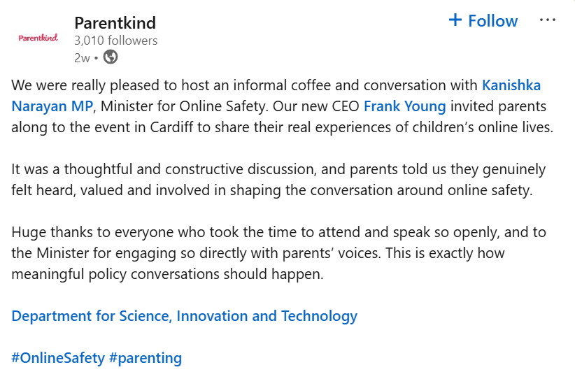
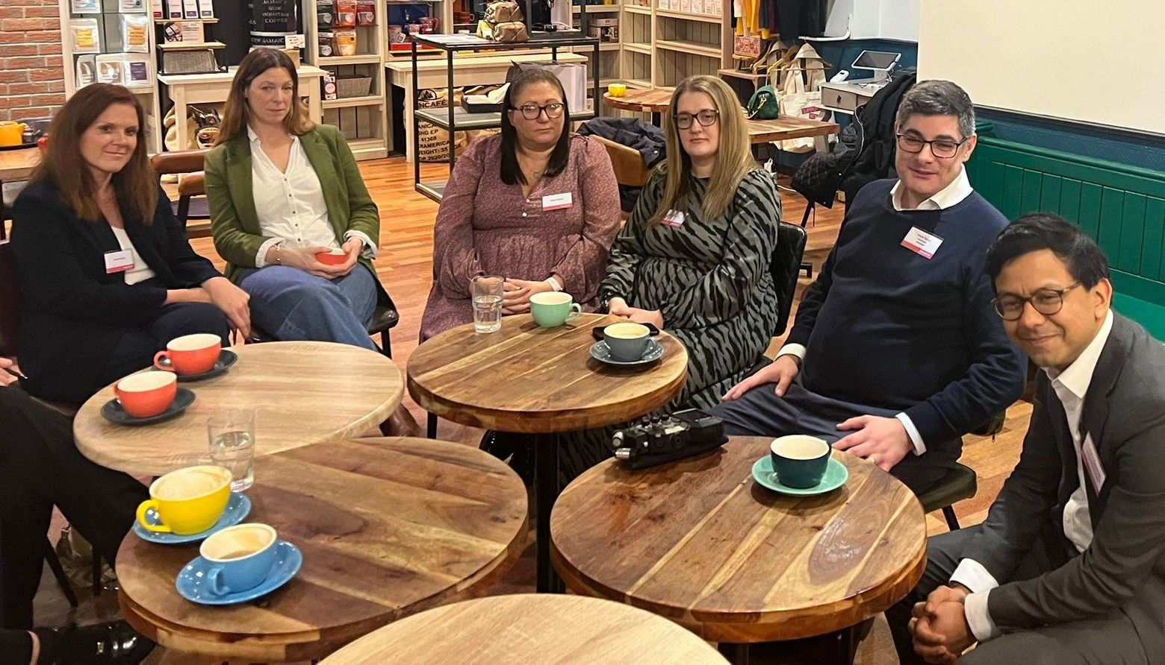
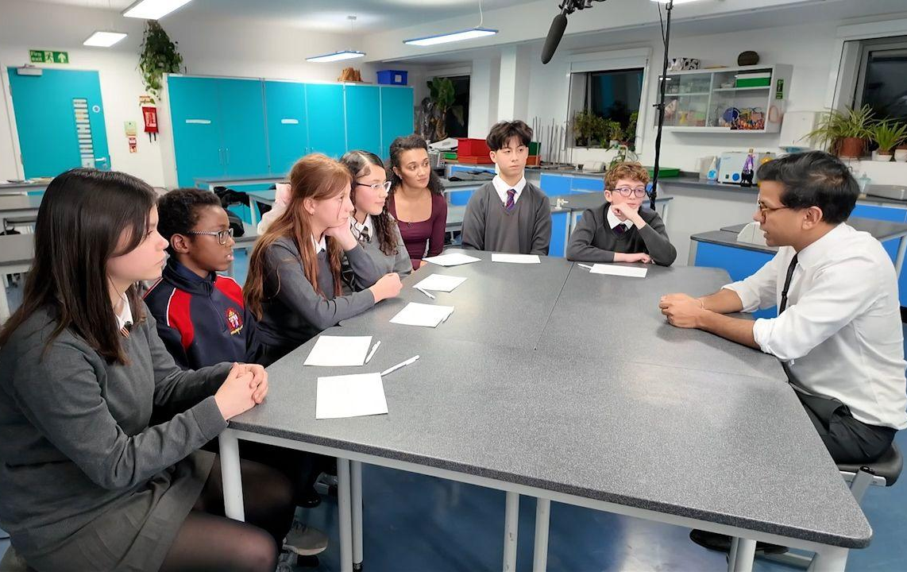
Examples of what your events could look like
The Children’s Commissioner invited London school students to ask the Minister consultation questions, covered by BBC Newsround
Parentkind hosted an informal coffee chat in Cardiff with parents and Minister Narayan about their children’s lived online experiences

