Slide 1
SEIC Youth Work and Schools Partnerships
Community of Practice
For Scotland's learners, with Scotland's educators
Notes:
Intro org, people and programme

Slide 2
Our Focus as a Community of Practice:
Partnership Planning and Evaluation
Outputs | Outcomes
4 x cross-sector meetings with youth work practitioners Opportunities to explore planning and evaluation resources for use with schools in local contexts A short report on the work we do together (June 2023) A learning event in summer 2023 co-designed with practitioners | Experience and skills to support collaborative planning and evaluation in youth work and schools partnerships Confidence to adapt and use new resources Clear recommendations on how to continue to embed good practice
Notes:
Context and purpose

Slide 3
YouthLink Scotland – Youth Work and School Partnerships Team
The YouthLink Scotland team is facilitating the Community of Practice. The team is funded by the Scottish Government through the Scottish Attainment Challenge, with a remit that includes:
Helping to build shared understanding of youth work’s role in the delivery of Curriculum for Excellence and Scottish Attainment Challenge
Providing ‘on the ground’ support for effective collaboration between youth work and schools, including the use of data and effective evaluation
Gathering and sharing evidence of what works and why
Developing and delivering collaborative professional learning opportunities to build capacity and encourage improvement
Notes:
Context and purpose

Slide 4
Practitioner reflections on experiences of planning and evaluating work with schools (Meeting 1)
As youth workers we understand the contribution we make to young people’s lives – in our work with schools we need a holistic understanding of young people’s educational journey which embraces and values youth work as a key component.
Schools are missing opportunities for young people because youth work is still too often seen as a resource to support ‘behaviour management’ / ‘patch up problems’ – and there are massive variations in the expectation and role of youth workers between schools, local authorities and across Scotland. How can we best communicate what youth work is and isn’t in a school setting –its value and its ability to enhance the curriculum?
Our experience tells us that there needs to be clear leadership and strategic buy-in, including a sustainable commitment to funding youth work, to enable change and a more proactive approach to joint planning and evaluation. We need to engage representatives of formal education and senior decision makers if we are going to help to make the change we want to see.
Notes:
Context and purpose

Slide 5
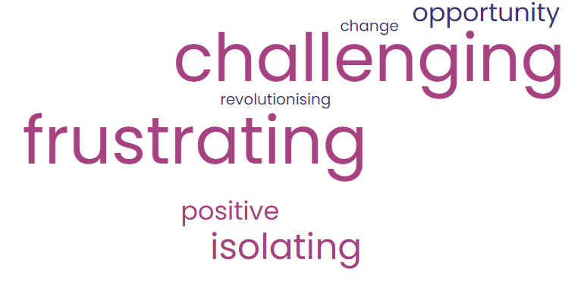
Practitioner reflections on experiences of planning and evaluating work with schools (Meeting 1)
We need better processes for JOINT planning and evaluating in collaboration with schools – to meet the needs of young peole - and reflect school and community improvement priorities.
It would be good to have a clear framework for engagement with schools that keeps youth work fundamentals at its heart. Youth work is not ‘school mark 2’.
Young people’s achievements through youth work (not just tariff points) need to be better recognised and recorded.
Often we’re not sure what happens with the evaluations we share with schools – where do they go? How do they inform decisions in school about pathways for young people? How do they inform service improvement?
Words the group chose to describe their CURRENT experience of joint planning and evaluation of youth work with schools (largest text = most commonly chosen word)
Notes:
Context and purpose

Slide 6
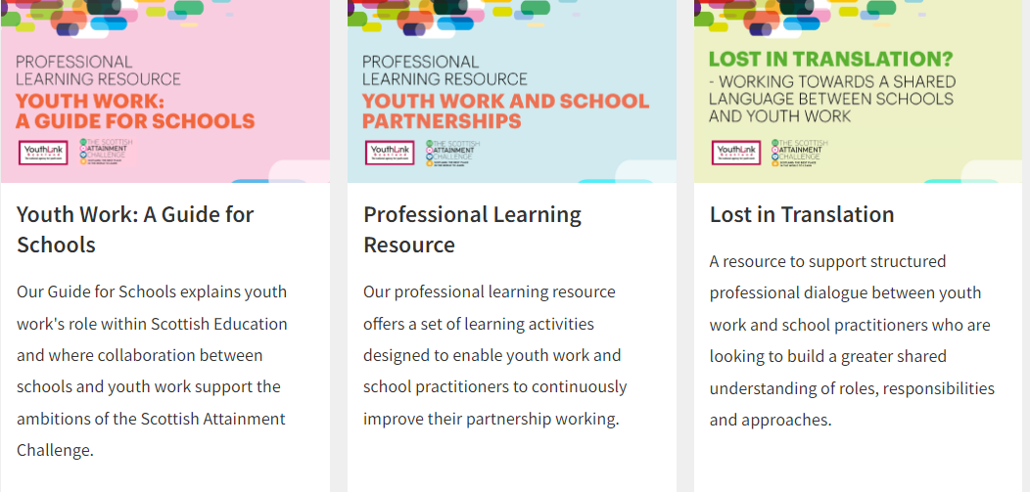
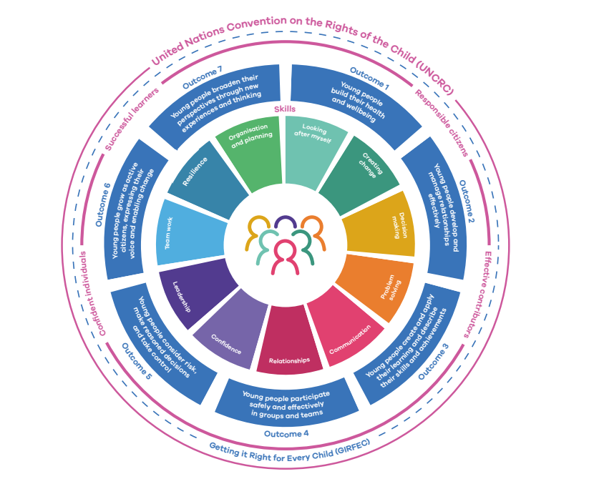
So what will make the Community of Practice a worthwhile investment of time for us as youth work practitioners?
We want to learn from each other and explore resources, developed nationally and in our own contexts, to support planning and evaluation….
AND we want to engage and influence teachers, school leaders and senior decision makers to build a better shared understanding of the value of youth work and the importance of planning and evaluating work together ….
We want schools / senior leaders in formal education to be part of our conversation about effective planning, evaluation and development of youth work in partnership with schools in the South East – how can we work together to influence and involve formal education partners in a dialogue about the opportunities we see?
National Resources to support planning and review with schools
YouthLink Scotland | Resources
National Youth Work Outcomes and Skills Framework
Youth Work Outcomes and Skills Framework | YouthLink Scotland
...And how can we ensure that young people are at the heart of this dialogue too?

