Slide 1
Basics of Meditation
Charlie Mooney

Slide 2
Welcome
My introduction to meditation.
Your experience with meditation
Game Time
What is meditation
The main event, lets meditate
Benefits to meditation
Signposting
Conclusion
One last challenge, random act of kindness

Slide 3
What meditation means to me
I was first introduced to meditation on international exchange,
a truly powerful experience
I personally am not sure about the spirituality of it all, but ultimately a opportunity to just be in the moment and focus.

Slide 4
Game Time Find the object
Find an object with first letter of your surname.
Find object closest to your age
Find a baby picture
Get a glass of water
Notes:
The water is for after meditation
Pick one of your items you feel comfortable to share and show and tell to group.

Slide 5
What is meditation
What is your experience of meditation? Virtual chat and audio if anyone would like to share vocally.
Meditation is the practice where individual uses a technique of mindfulness or focus or even activity to train attention and awareness and achieve a mentally clear and emotional state of mind.
Notes:
What is your experience of meditation, remember my interpretation of being in moment was very varied and yours could be too.
I honestly feel we all have meditation techniques we use without even thinking about it. The activity based meditation referred to is probably YOGA where breathing, balance and focus are all required. I have found the same results in MTB. Breathing and balance are required and if you don’t focus your guaranteed to be heading for a tree, so you are completely in the moment. Any worries about money, relationships ,who's going to win next election are gone for the duration of the trail. The feeling of being lost in the moment is powerful and made me realise time for me to be away from my own thoughts essential to distressing.

Slide 6
Meditation
Meditation has been around for thousands of years, first recorded in 1500BC in Hinduism.
Though based in Asian religious and spiritual beliefs it has been transferred to business and health format for western society.
There are several recognised meditation structures that range activity based YOGA, self meditation, Led meditation ( we will do that tonight)

Slide 7
Let meditate!
Get comfortable and close your eyes
Notes:
Remind student not to lay down but get in a comfortable position.
Focus on the sounds around you, no matter what they are traffic, birds, voices this is your background music and your in the moment.
As you let the noise blend in the background listen to my instruction and just relax.
Breath in through your nose and out through your mouth, big deep breaths.
In ………….. And out…………. As you breath I want you to focus on the moment an inhale becomes and exhale and a exhale becomes an inhale.
In……..that moment and exhale………there it is again
In ………. And ……………out
As thoughts come to your mind don’t fight them, let them in and let them straight back out. This is your time the day is long 24 hours to be exact this time is yours, any worry you have can be left at the door and if you choose pick it up at end. But these few moment are yours.
In ………. And out………… feel a calmness overtake you and the daily grind just float away for this time, your time, this few moments that your claiming as you sanctuary.

Slide 8
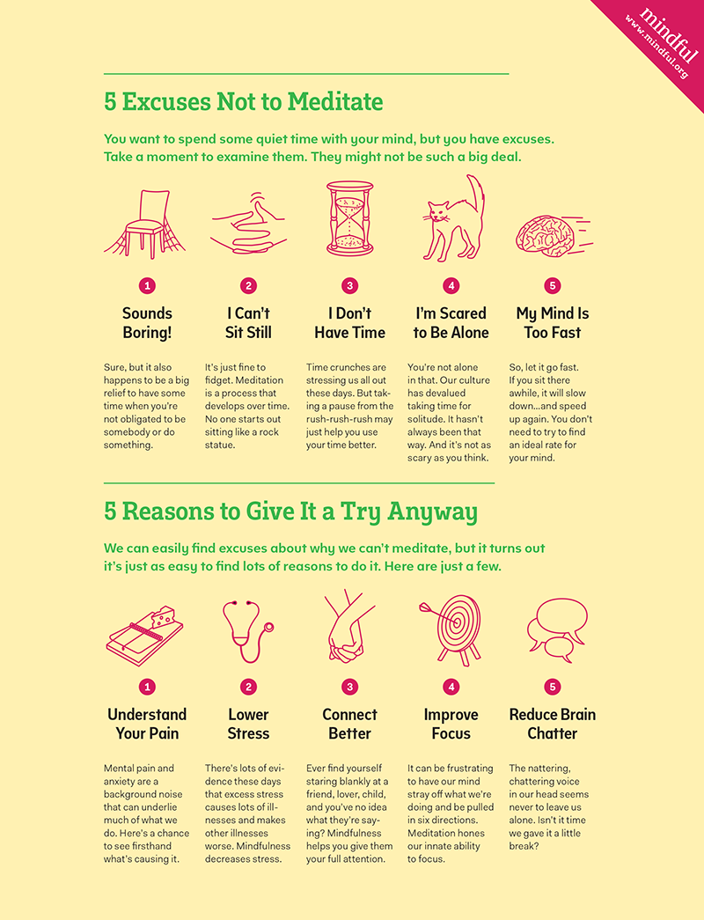
Barriers and Benefits of meditation
Notes:
5 mins
Discuss information on slide, do we agree disagree?

Slide 9
Signposting
Meditation centres- Glasgow Kadampa Meditation centre, Innerspace meditation centre, transcendental meditation Glasgow.
Online support, youtube 10 minute meditation for anxiety, mindful.org
Glasgow Life virtual groups
Notes:
5 mins

Slide 10
Conclusion
I hope you are all feeling the benefits of taking that time out.
I mostly hope you realise the importance of time for yourself
Take the basic method and apply it to your day
Notes:
3 mins
Take the basic method and apply it to your day on the bus, in your room just the basic of taking time for you by focus on breathing and letting your worries leave you. It when you realise worrying is pointless and how better you can feel without worry the real awareness and mindfulness takes place.

Slide 11
One last challenge
Random act of Kindness
Notes:
5 mins
In the apps Alan asked you to review there was a App from NHS, it was about random act of kindness and the well being felt by not only benefactor of act but the administrator. The person delivering kind act just feels better about themselves. This is an experiment, I will try it too, basically tell someone they are doing a great job, or they are good friend, send a picture of a fluffy pet to a pal. Anything that passes a smile to another human being.
I am looking for three acts of kindness from each of you.
Try to record the acts via video, picture however you can and on next meeting we want to hear all about it.

